Slide 1
SAS® Training
Basic SAS Procedures – Part 2

Slide 2
Topics covered…
PROC Freq
Options
Using formats
Missing data
Order=
Multi-dimensional tables
Statistics

Slide 3
Topics covered…
PROC Means
Options
Class statement
Missing data
Output statement
_TYPE_ and Chartype
ODS NOPROCTITLE

Slide 4
Topics covered…
PROC Univariate
Options
Class statement
FREQ
Output statement
INSET
PROBPLOT
QQPLOT
WEIGHT

Slide 5
PROC Freq

Slide 6
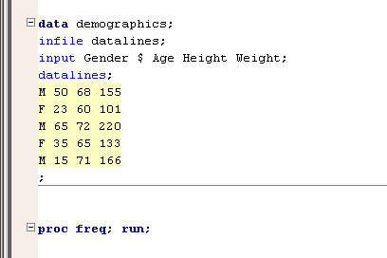
PROC Freq
PROC Freq can be used to run simple frequency tables on your data

Slide 7
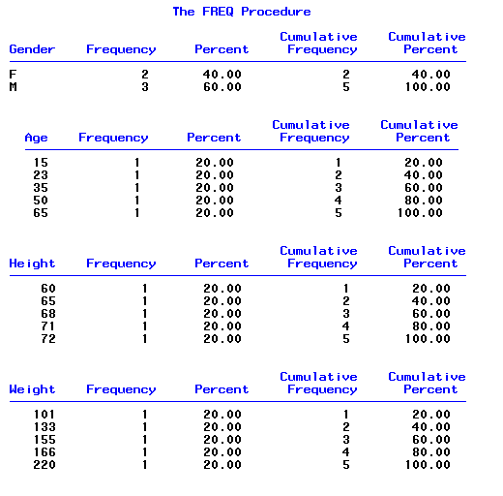
PROC Freq
Results of PROC Freq of “Demographics”

Slide 8
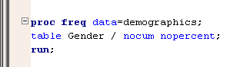
PROC Freq
Use the table statement to only print selected variables
Use the nocum option to suppress cumulative statistics
Use the nopercent option to suppress percent statistics
Can use options together or separately

Slide 9
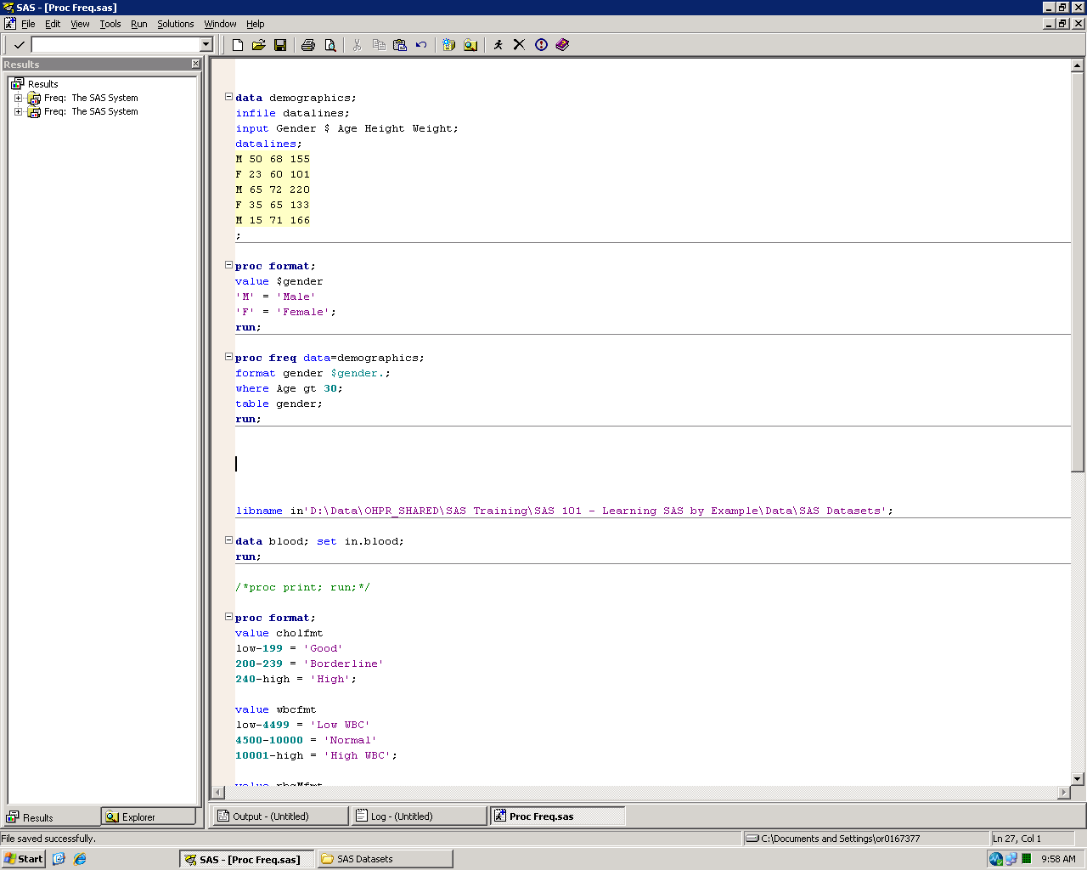
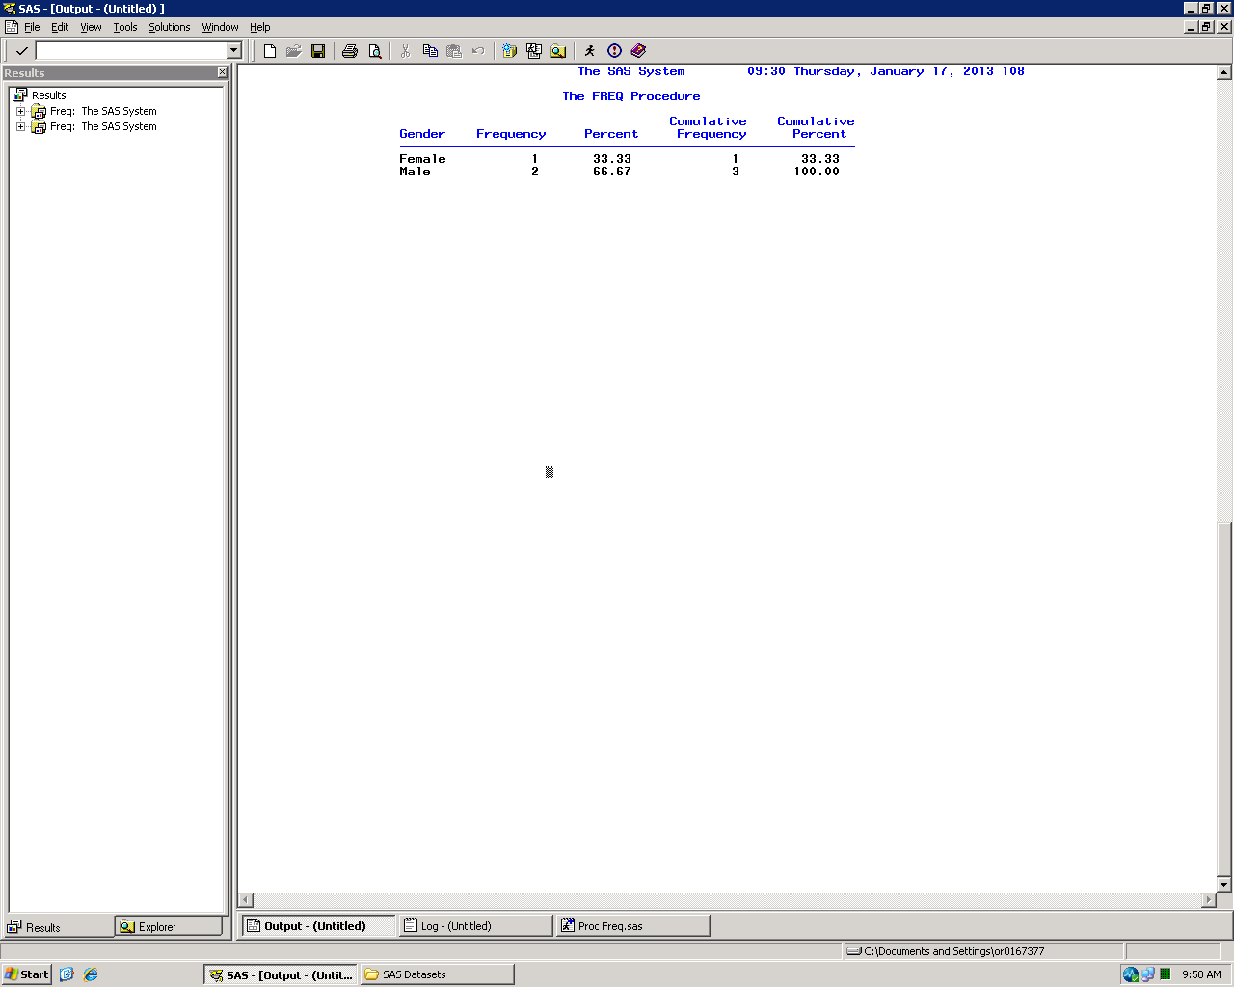
PROC Freq
where statement – Only include selected observations
format statement – Apply format to selected variables
Only applies to current procedure
Can be used to group data

Slide 10
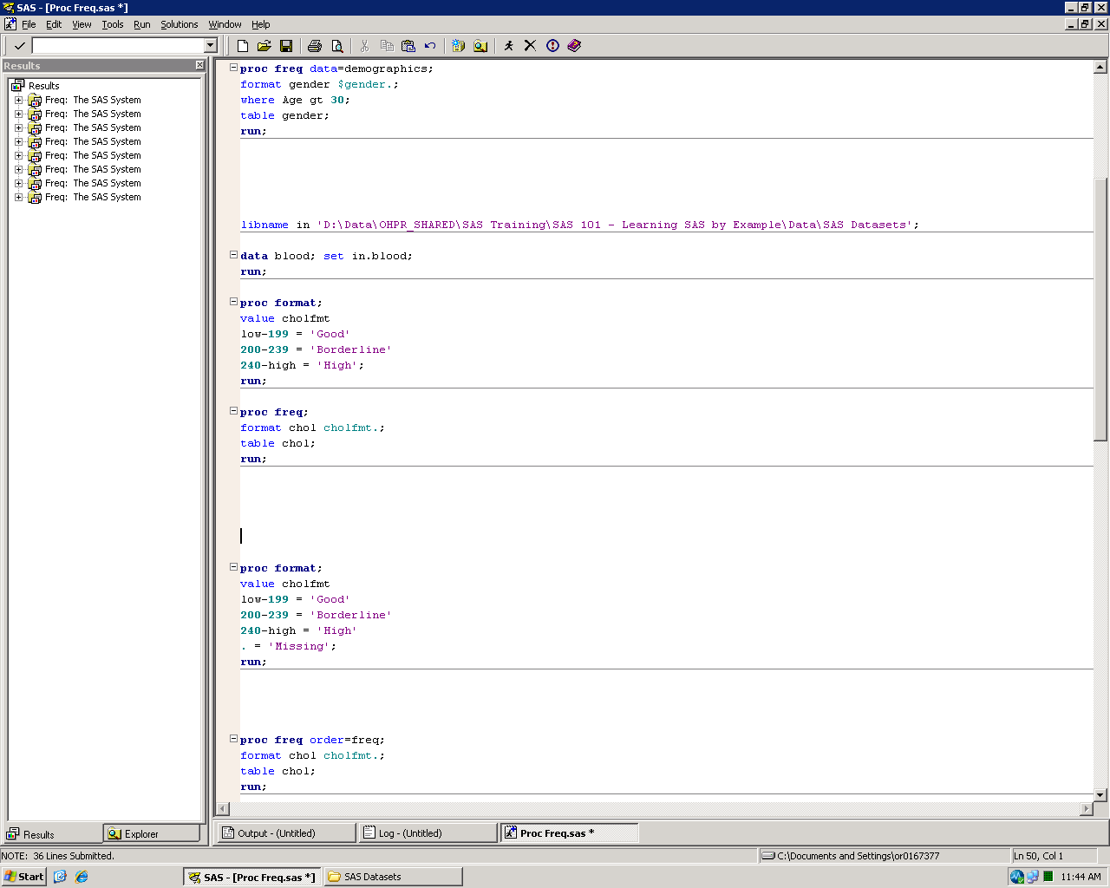
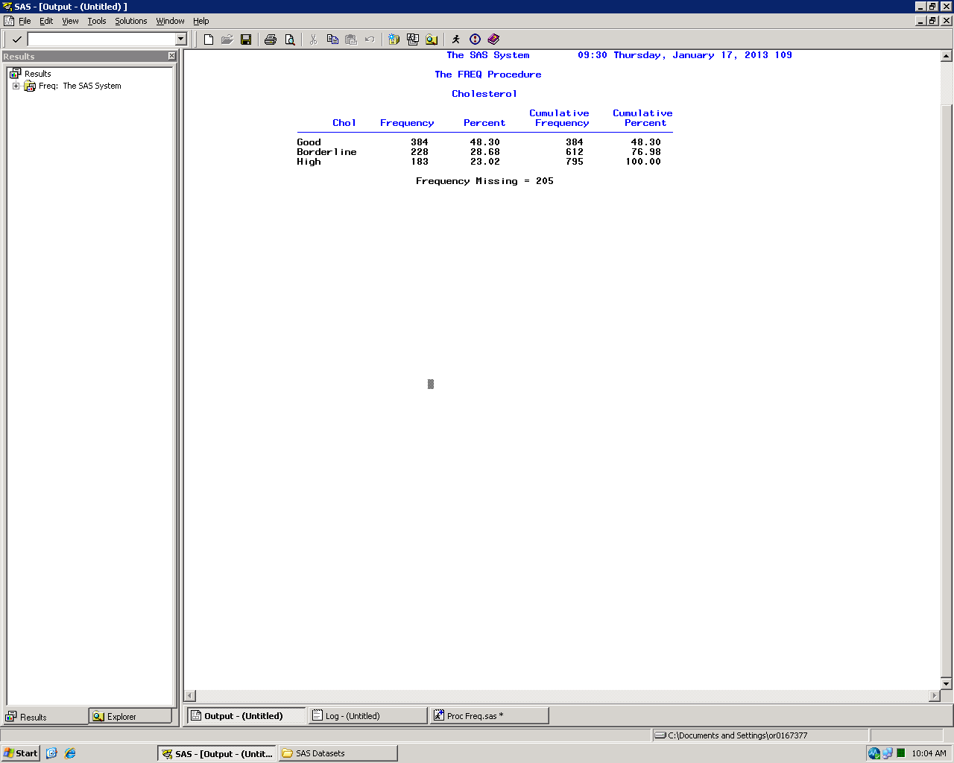
Using formats
Use formats to group data

Slide 11
Missing data
Missing data will be excluded from the analysis
Will affect percent calculations

Slide 12
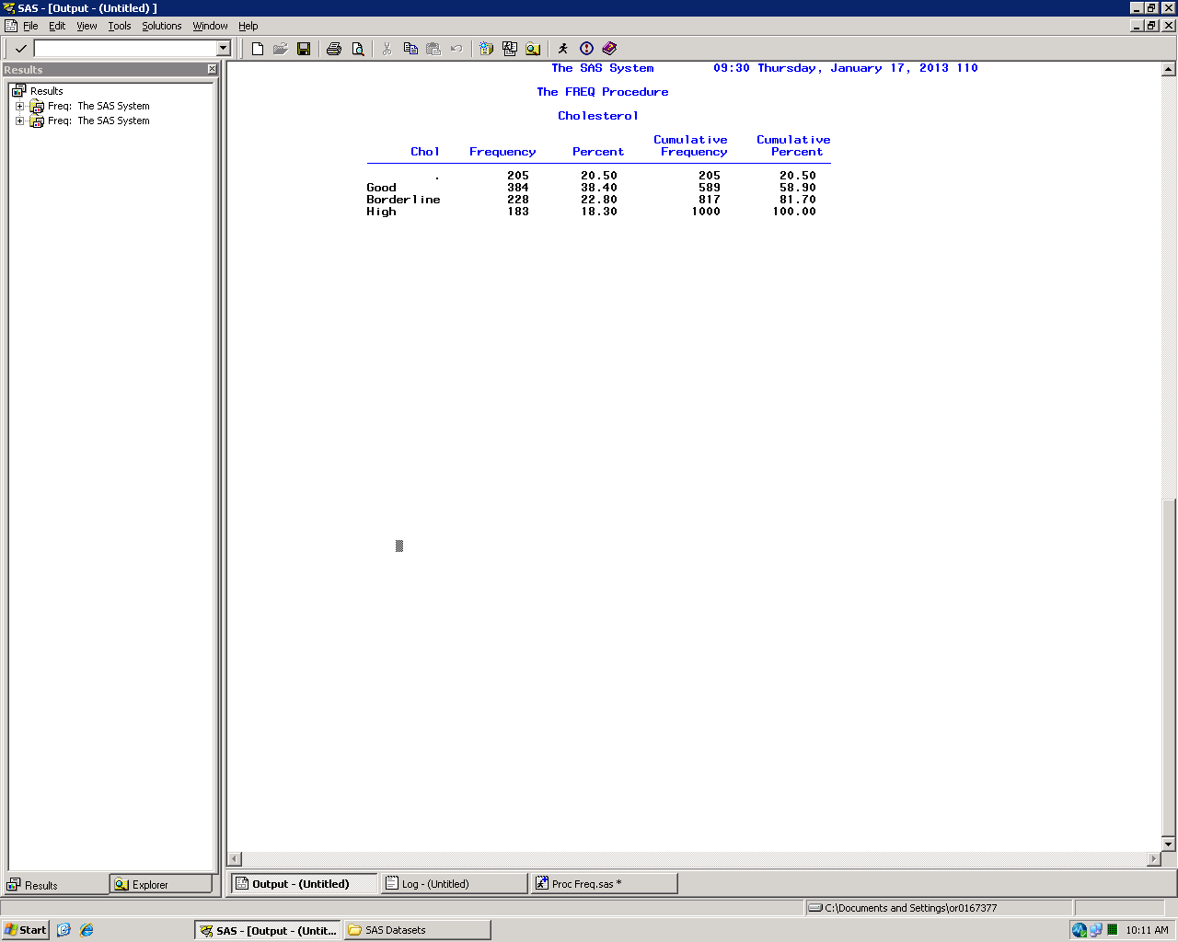
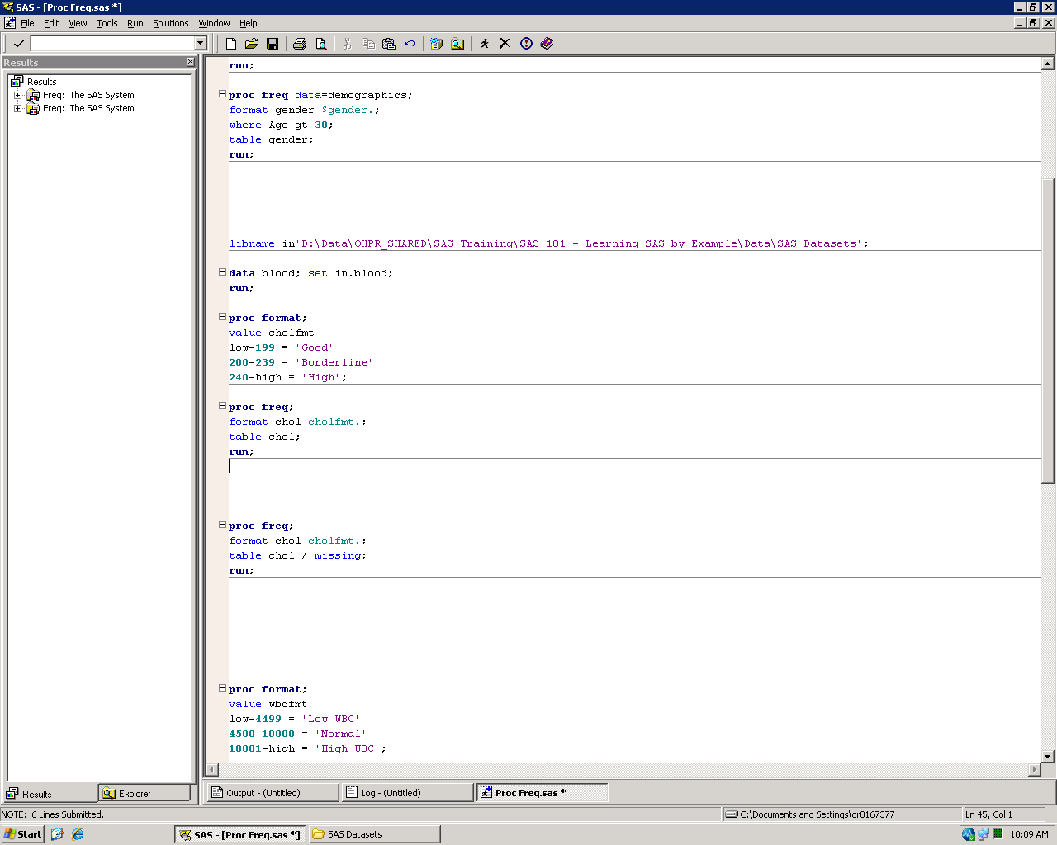
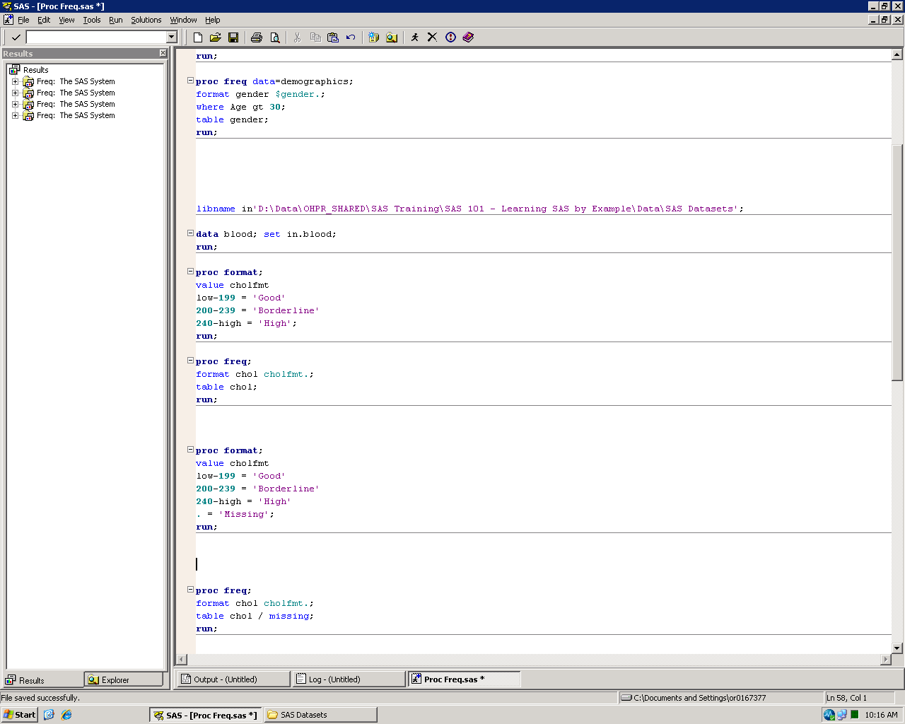
Missing data
Use the missing option to include missing values in the frequency table
Can also create a label for missing values in your PROC Format

Slide 13
Order=
By default PROC Freq orders your frequency table based on the internal (unformatted) values
Use the order= option to change the order
Missing values, if included in the table, will always be listed first regardless
order= | Results
internal | (Default) Order values by their internal (unformatted) values
formatted | Orders values by their formatted values
freq | Order values from the most to least frequent
data | Orders values based on their order in the input dataset

Slide 14
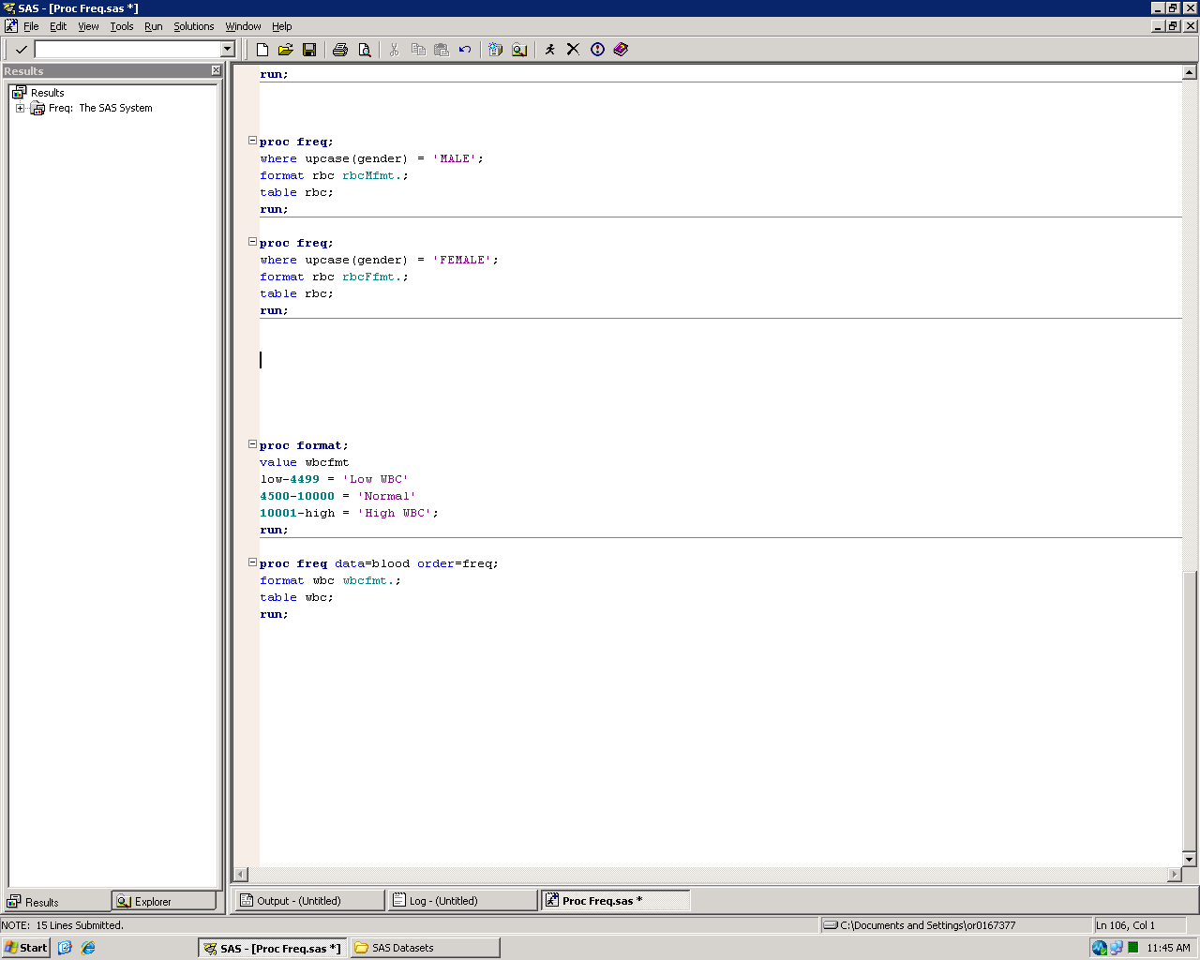
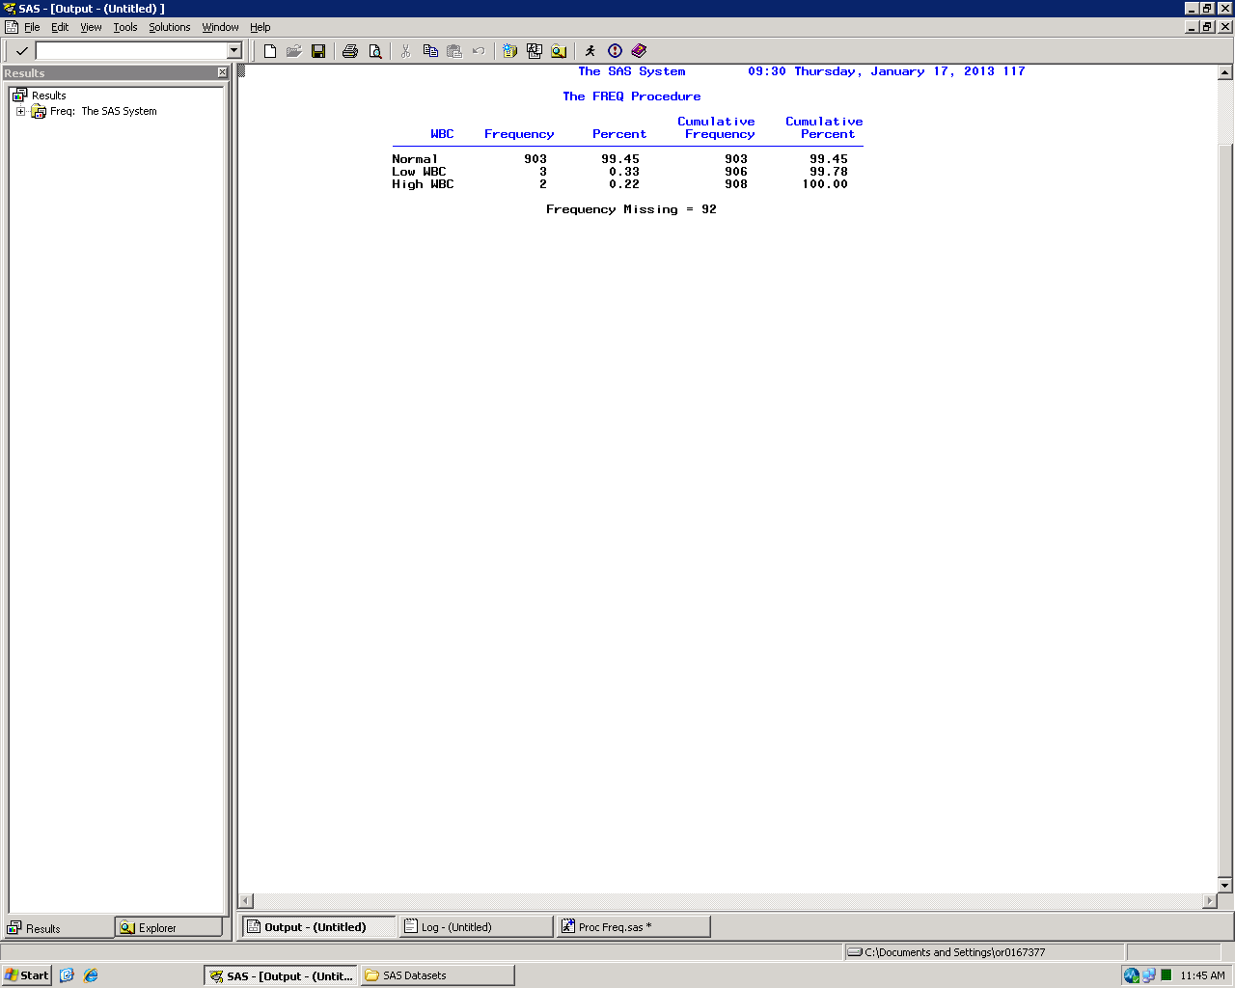
Order=

Slide 15
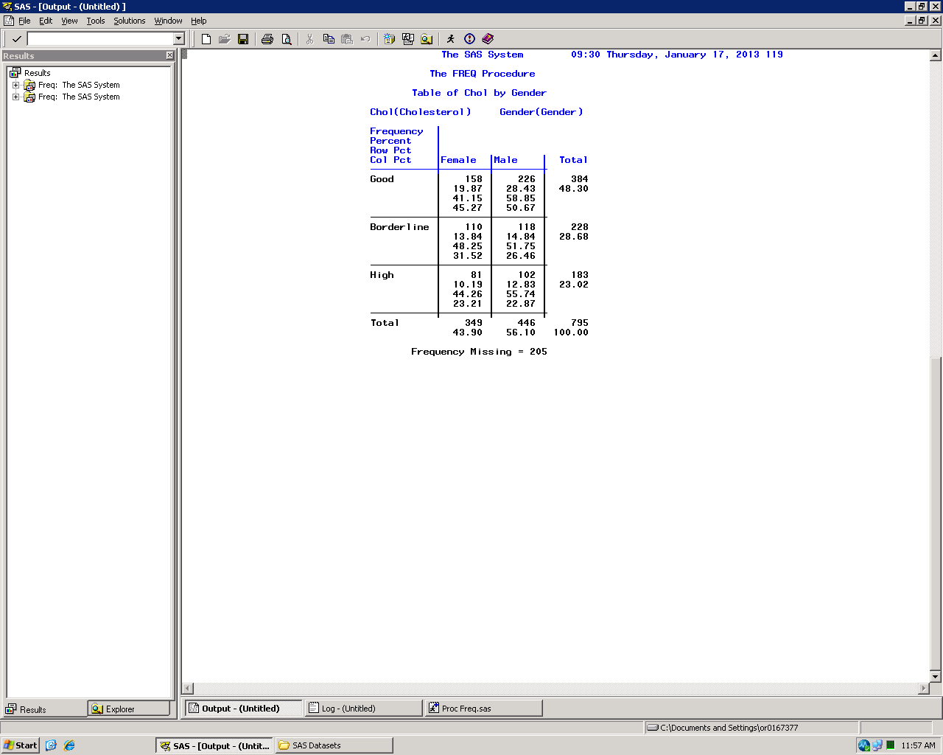
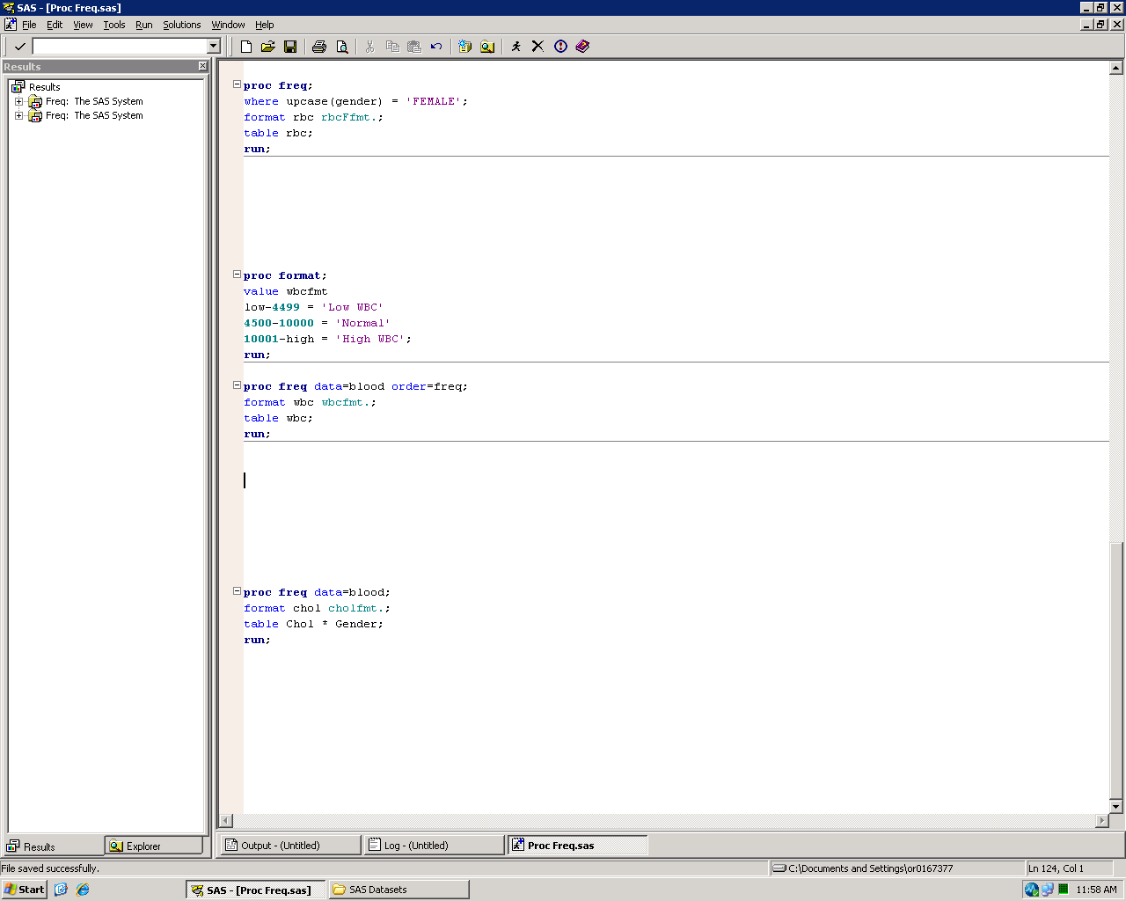
Multi-dimension tables
Can create simple cross-tabulations

Slide 16
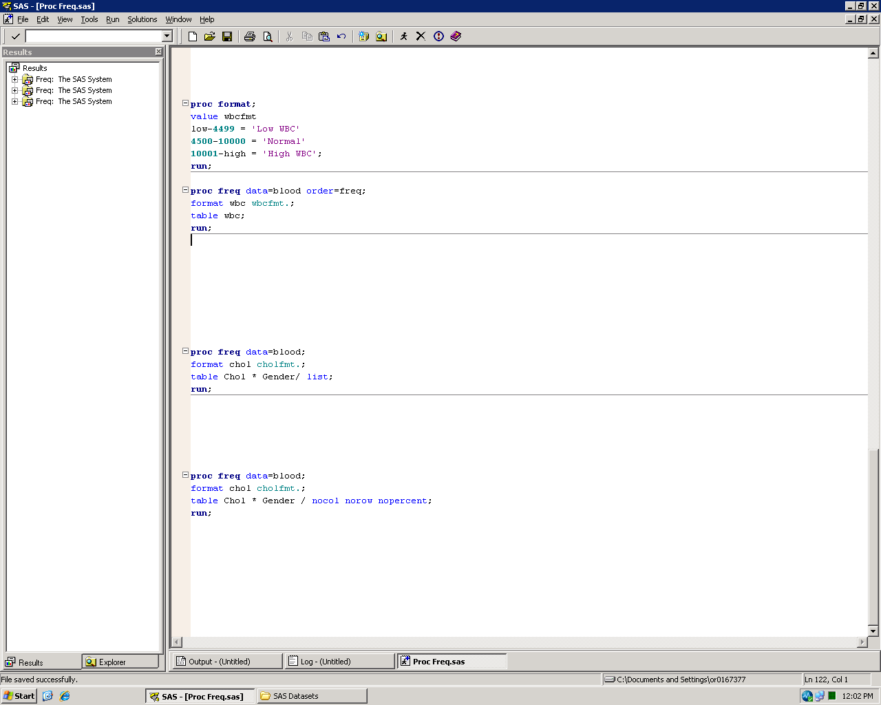
Multi-dimension tables
Use the nocol option to suppress column percent statistics
Use the norow option to suppress row percent statistics
Use the nopercent option to suppress total percent statistics
Can use options together or separately

Slide 17
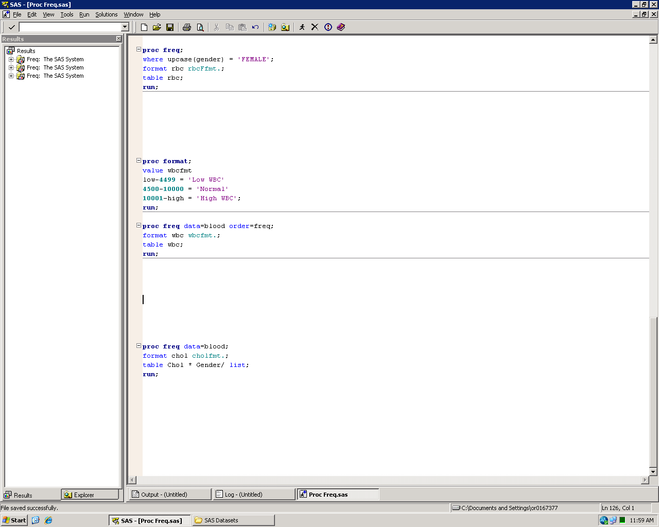
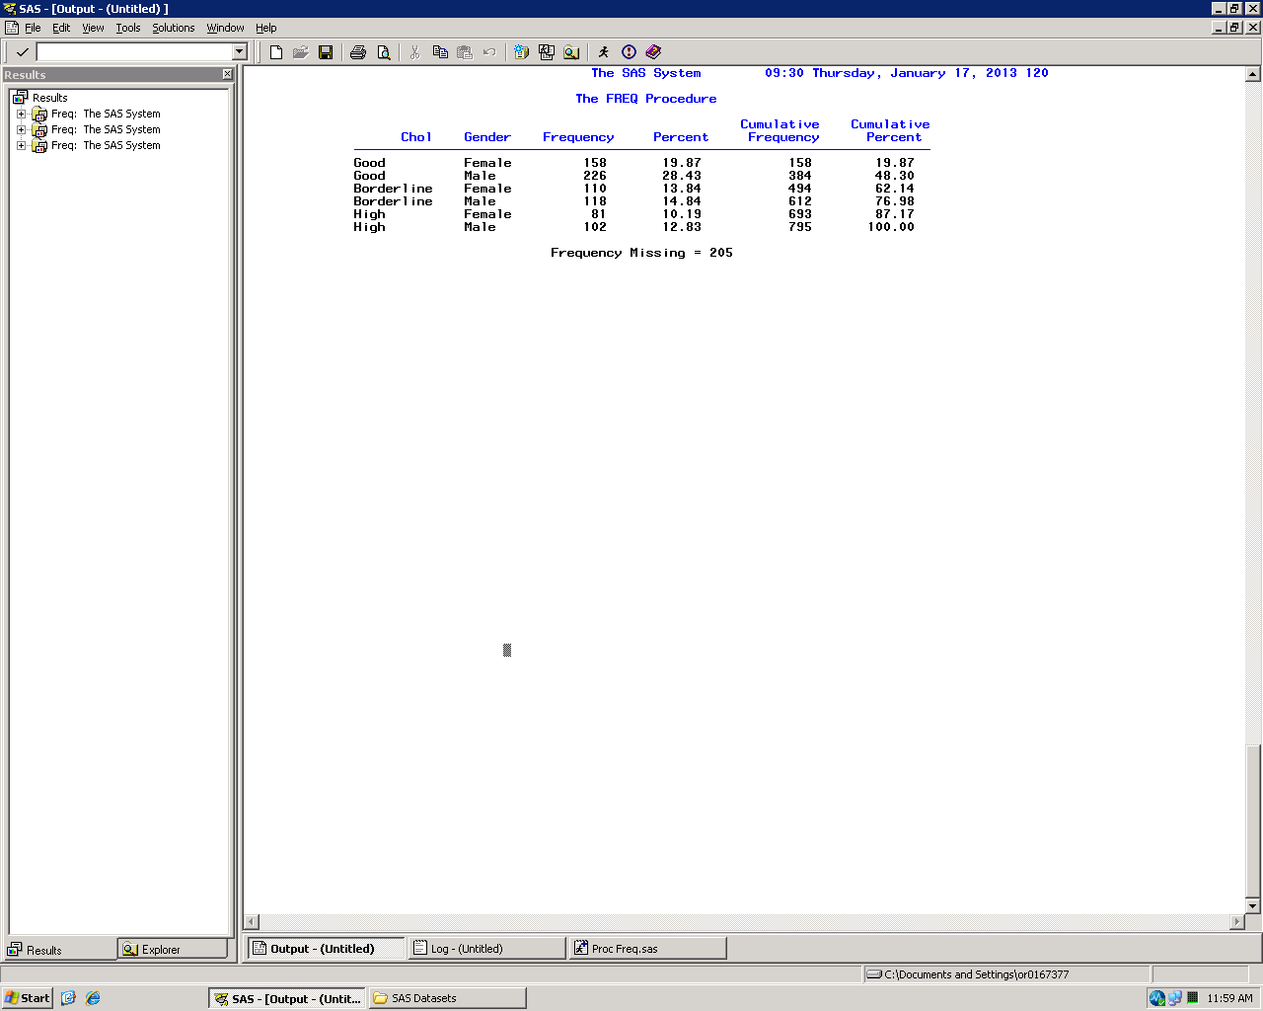
Multi-dimension tables
Use the list option to display cross-tab tables in a list format

Slide 18
Multi-dimension tables
There are multiple ways to request tables:
Notation | Result
table A * (B C D); | Three tables: A by B; A by C; A by D
table (A B) * (C D); | Four tables: A by C; A by D; B by C; B by D
table A * B * C; | One three-way table with the format Page * Row * Column. Each classification of A would appear on a separate page.
table Ques1 - Ques10; | Ten tables, one each for Ques1 through Ques10
table VarA -- VarB; | One table each for all variables between VarA and VarB in the SAS dataset (by varnum)
table Ques: ; | One table each for all variables that begin with “Ques”
table _numeric_; | One table each for all numeric variables
table _character_; | One table each for all character variables
table _all_; | One table each for all variables

Slide 19
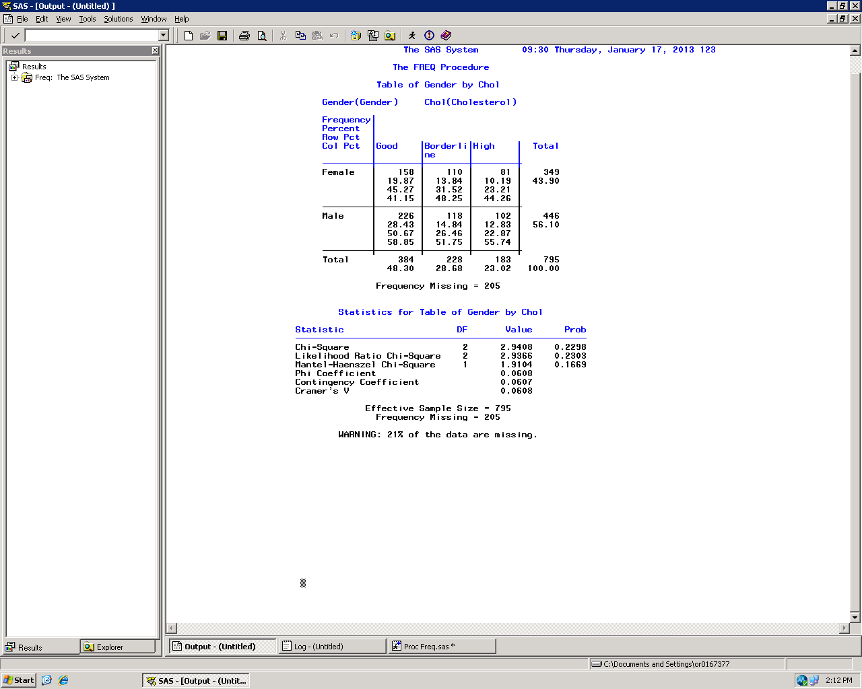
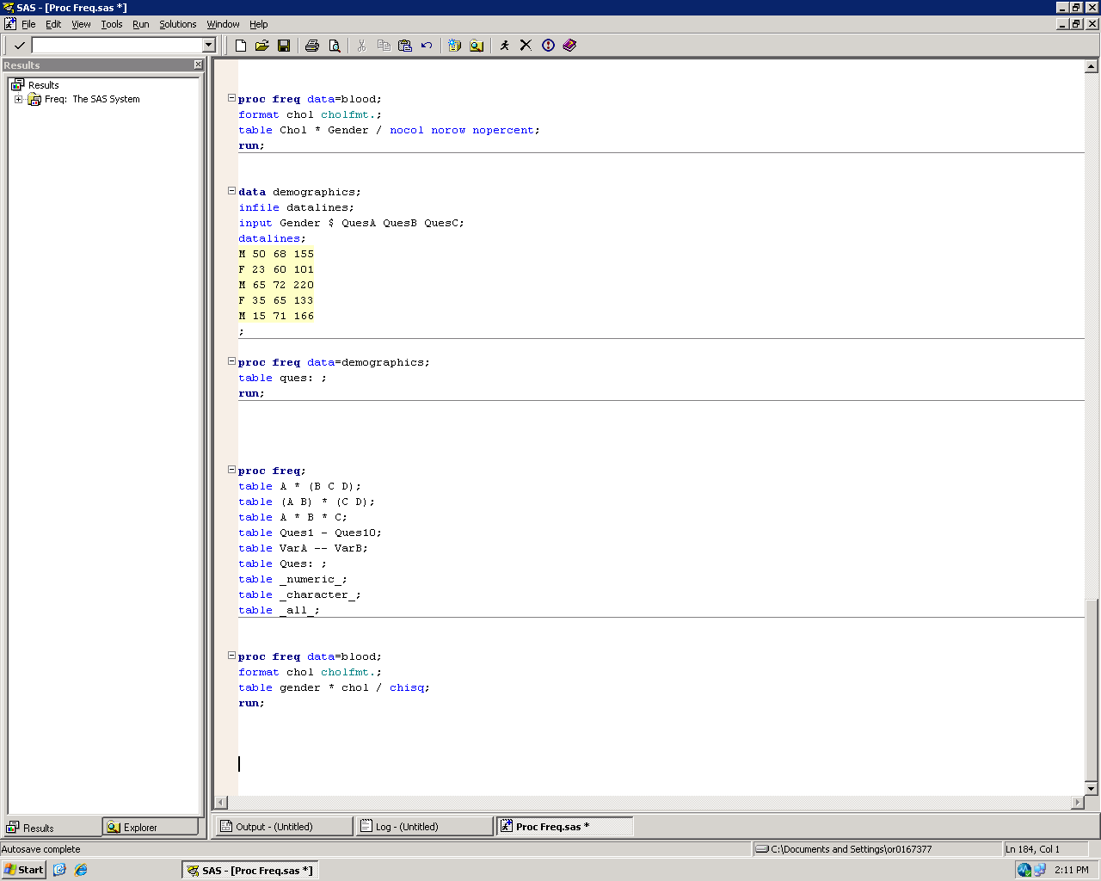
Statistics
PROC Freq is also used to calculate certain statistics, such as chi-square, odds ratio, and relative risk

Slide 20
PROC Means

Slide 21
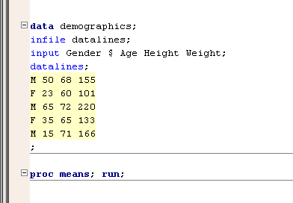
PROC Means
PROC Means can be used to run simple summary statistics on your data

Slide 22
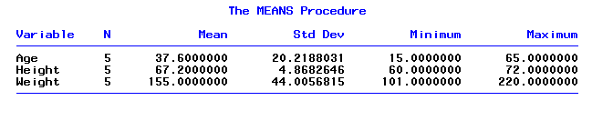
PROC Means
Results of PROC Means of “Demographics”

Slide 23
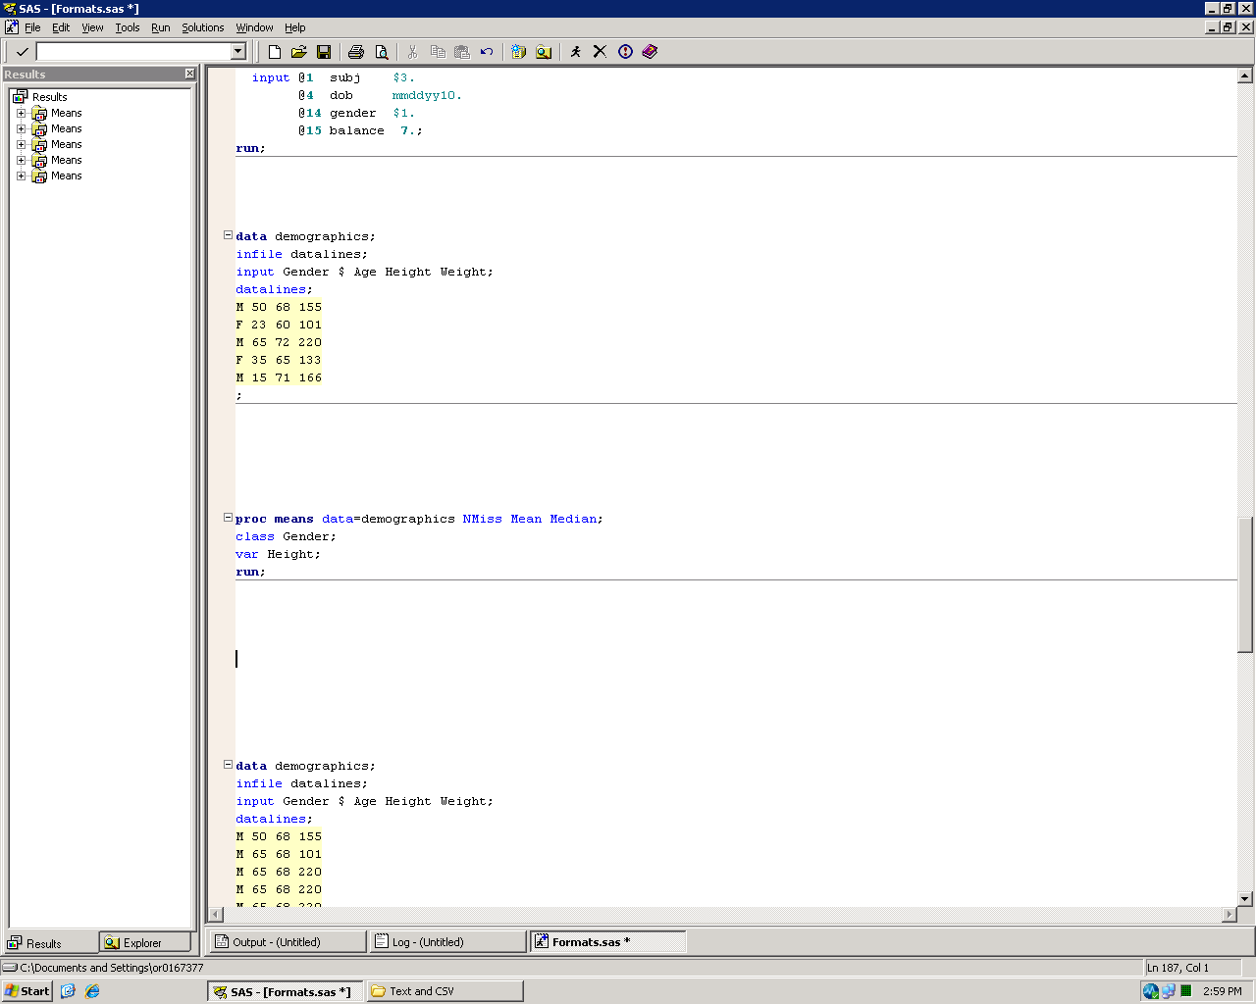
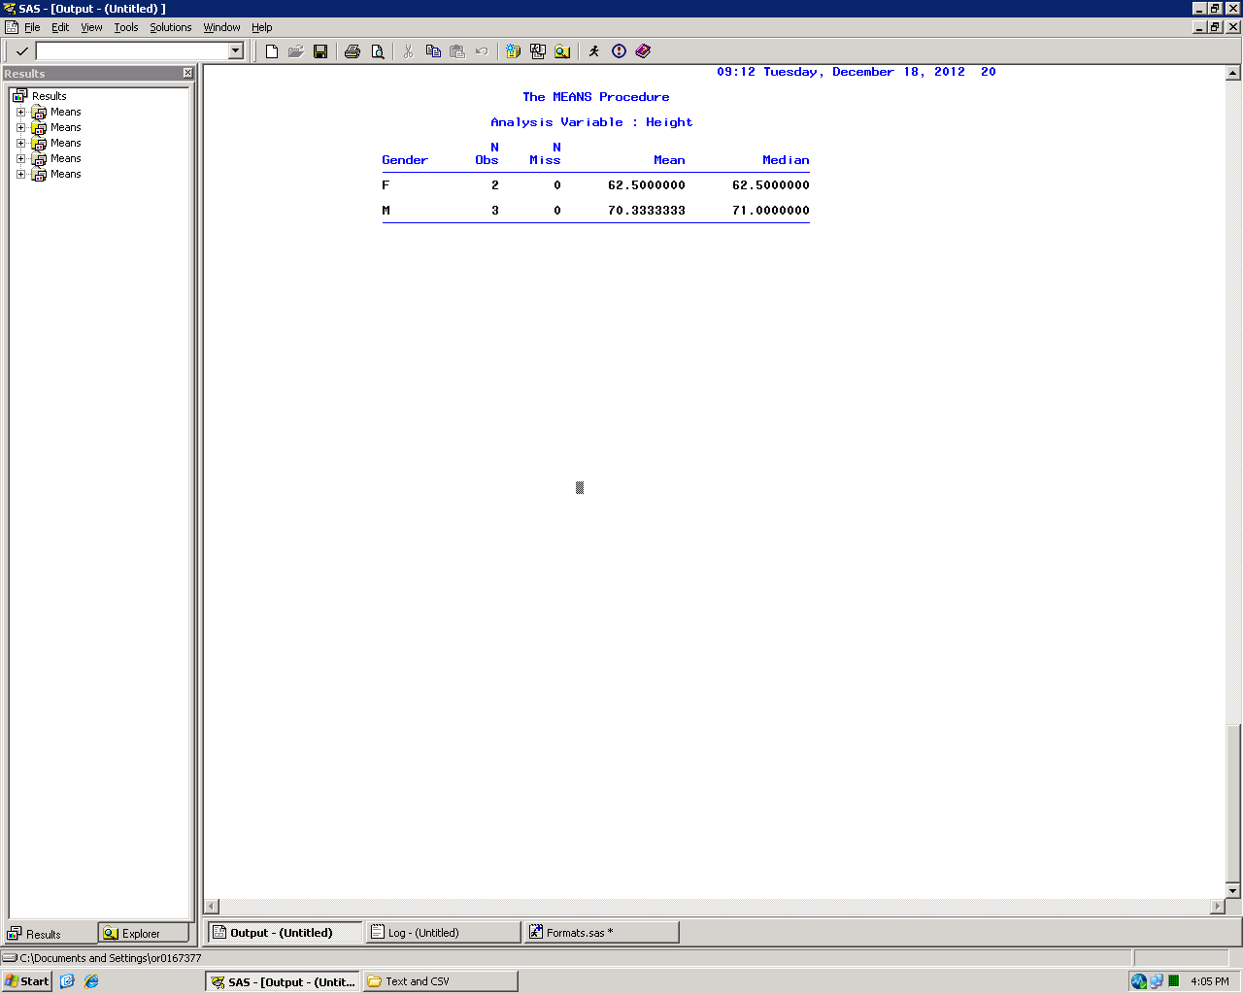
PROC Means
Many options to control output of PROC Means
NMiss Mean Median – Examples of statistics that can be specified in PROC Means
(see later slide for list of statistical keywords)
class statement – Allows for grouping by categorical variables
var statement – Only provides statistics for listed analysis variables

Slide 24
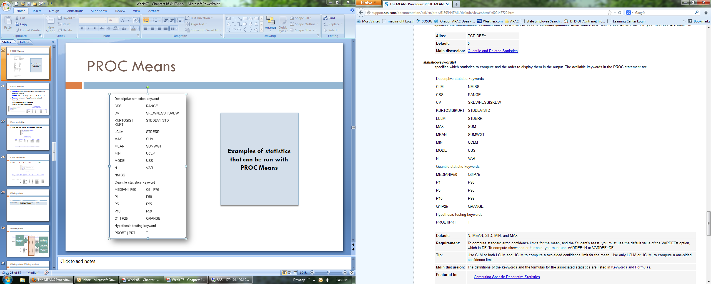
PROC Means
Statistics available in PROC Means

Slide 25
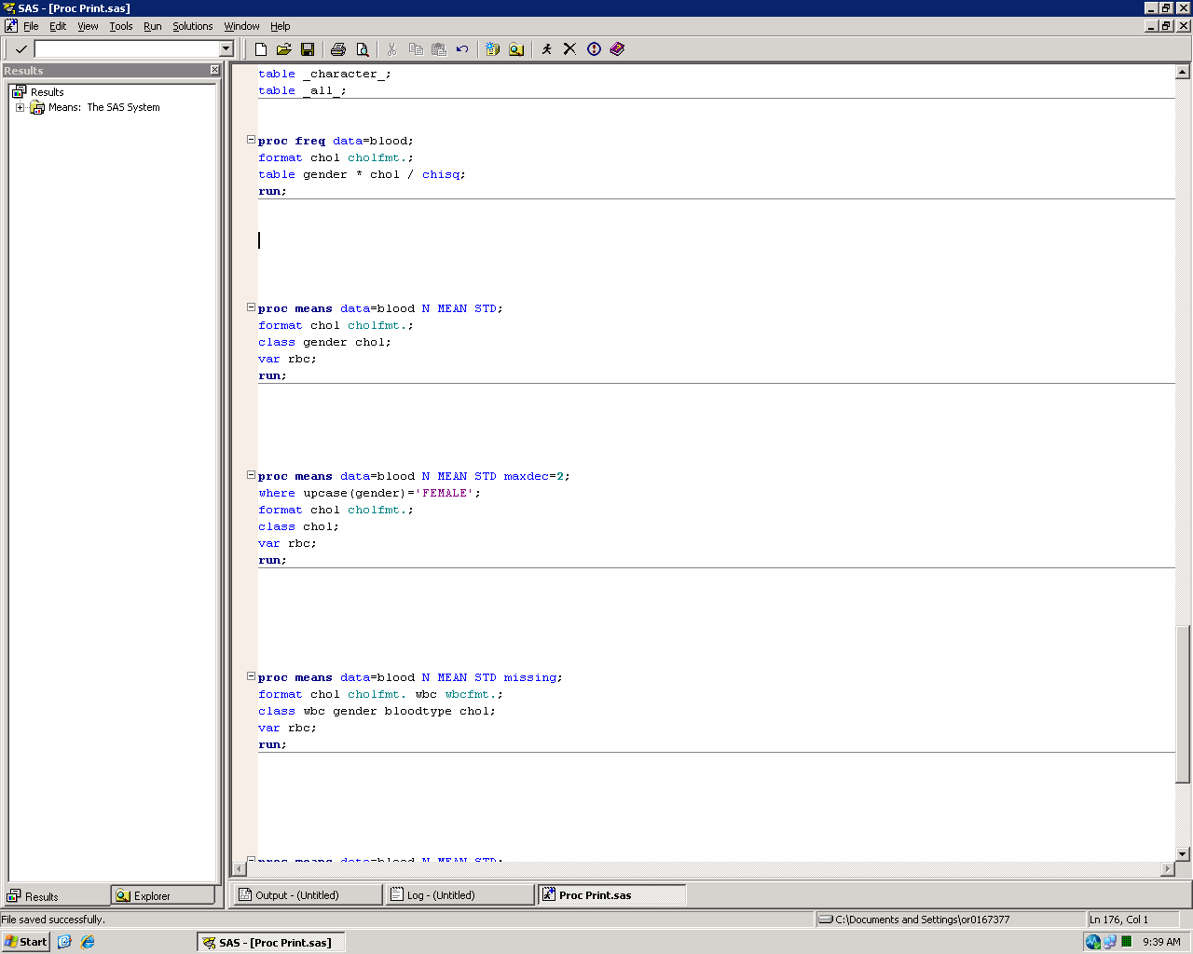
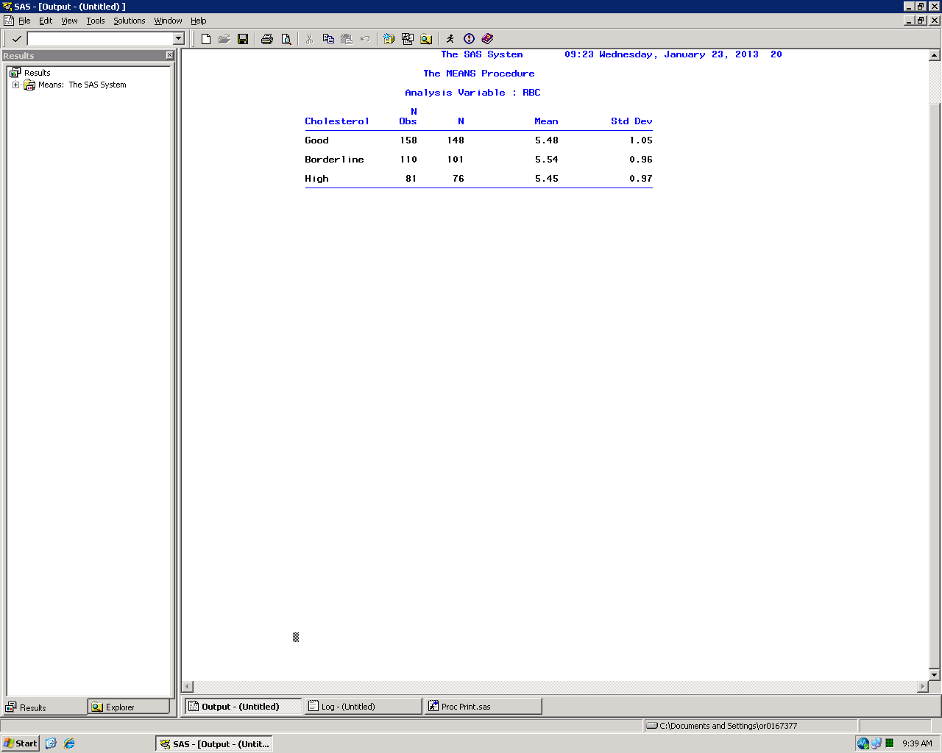
PROC Means
maxdec= option – Specifies the number of decimal places for statistics
where statement – Only include selected observations
format statement – Apply format to selected variables
Only applies to current procedure
Can be used to group class data

Slide 26
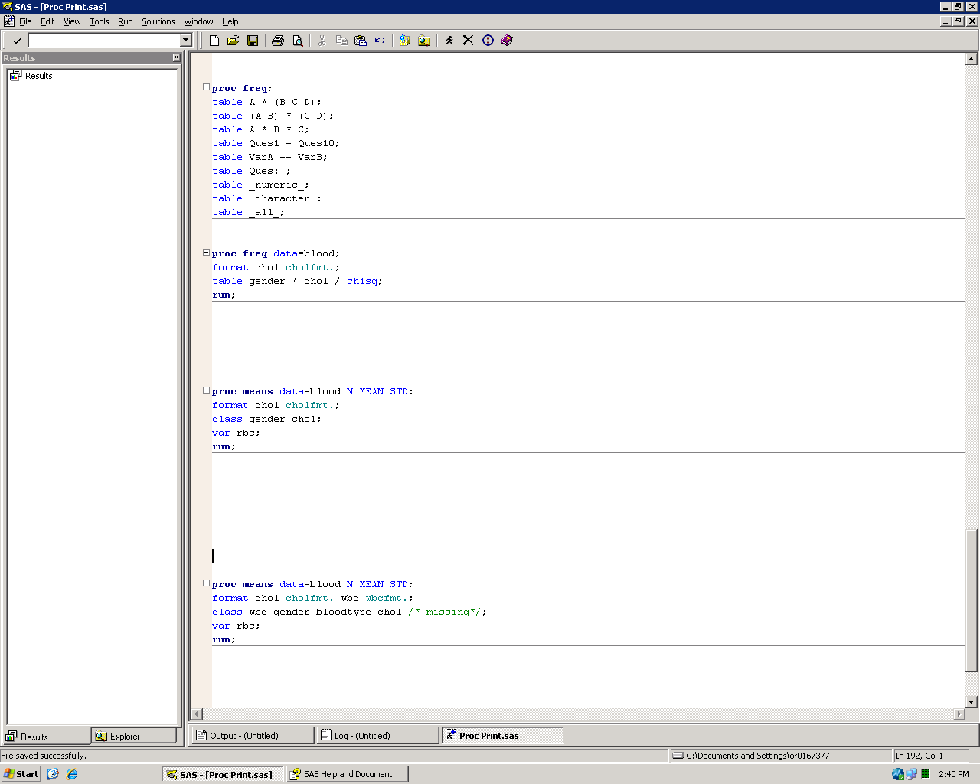
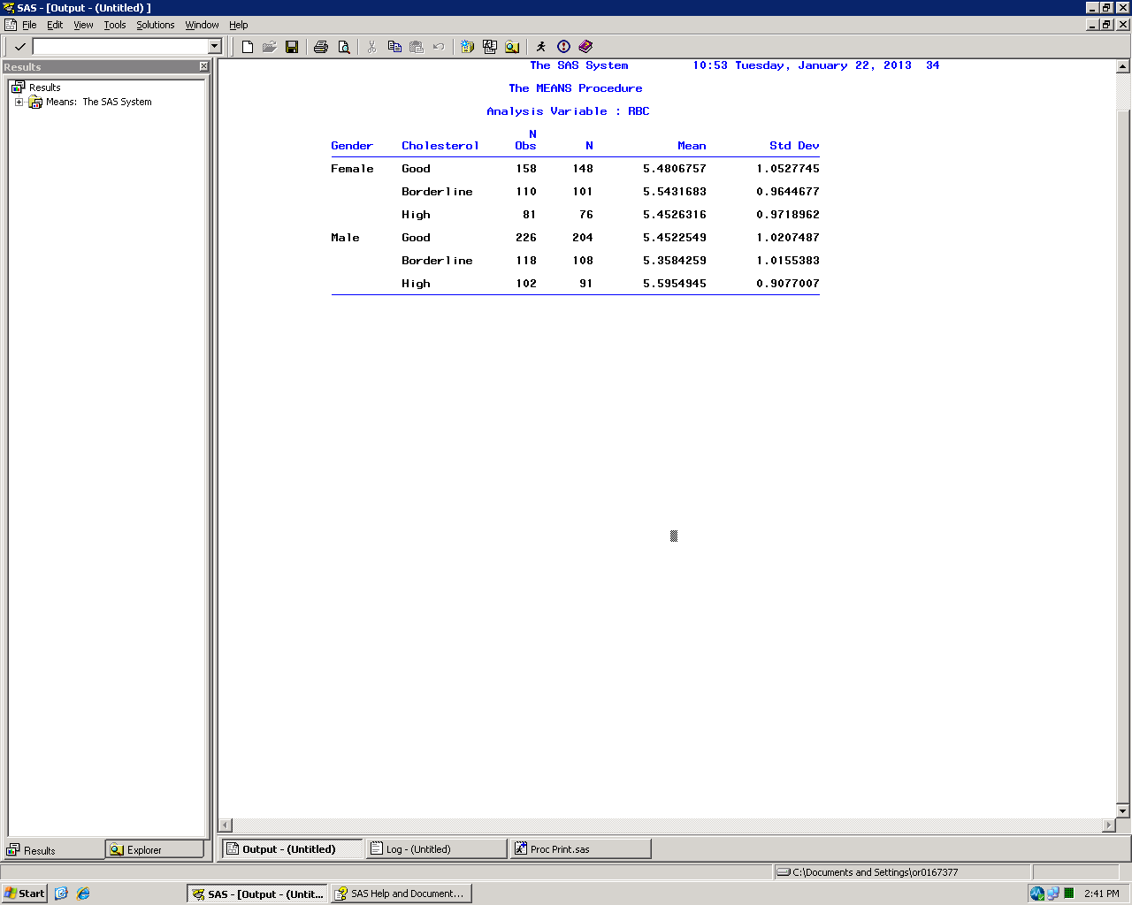
Class variables
Table can also include multiple class variables

Slide 27
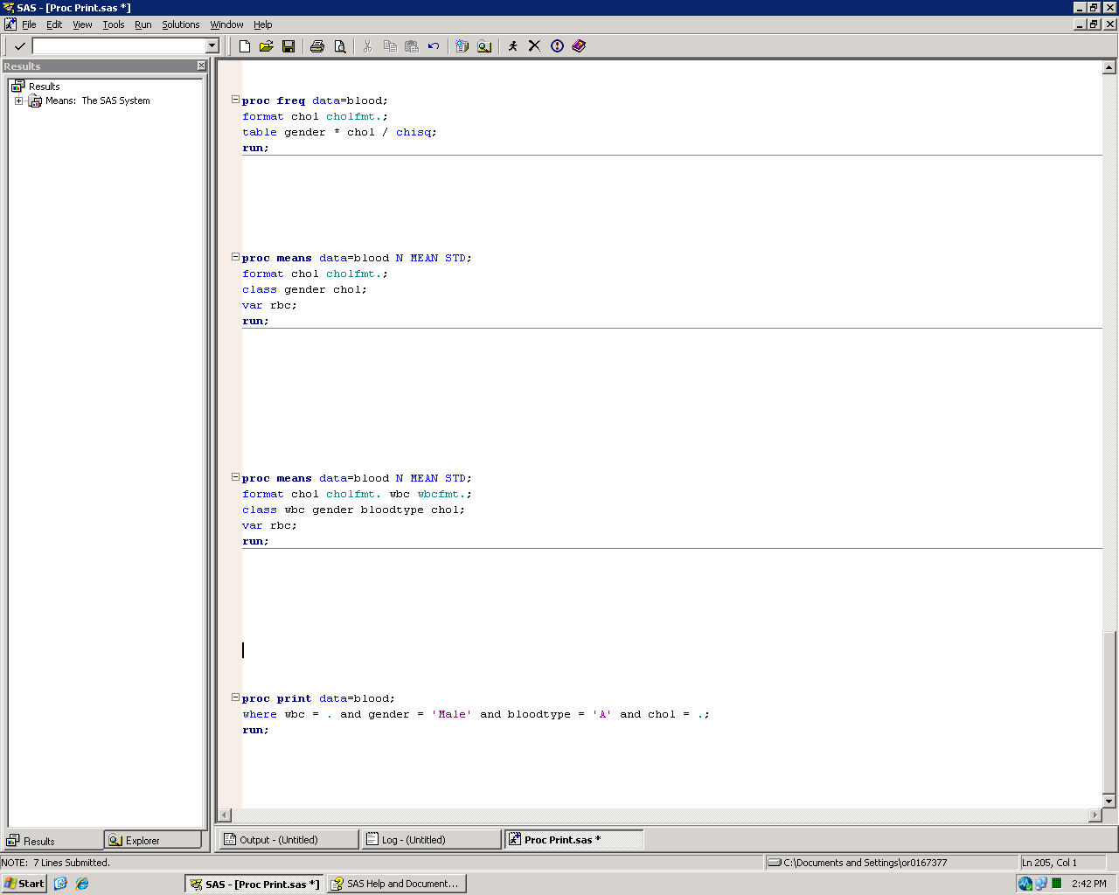
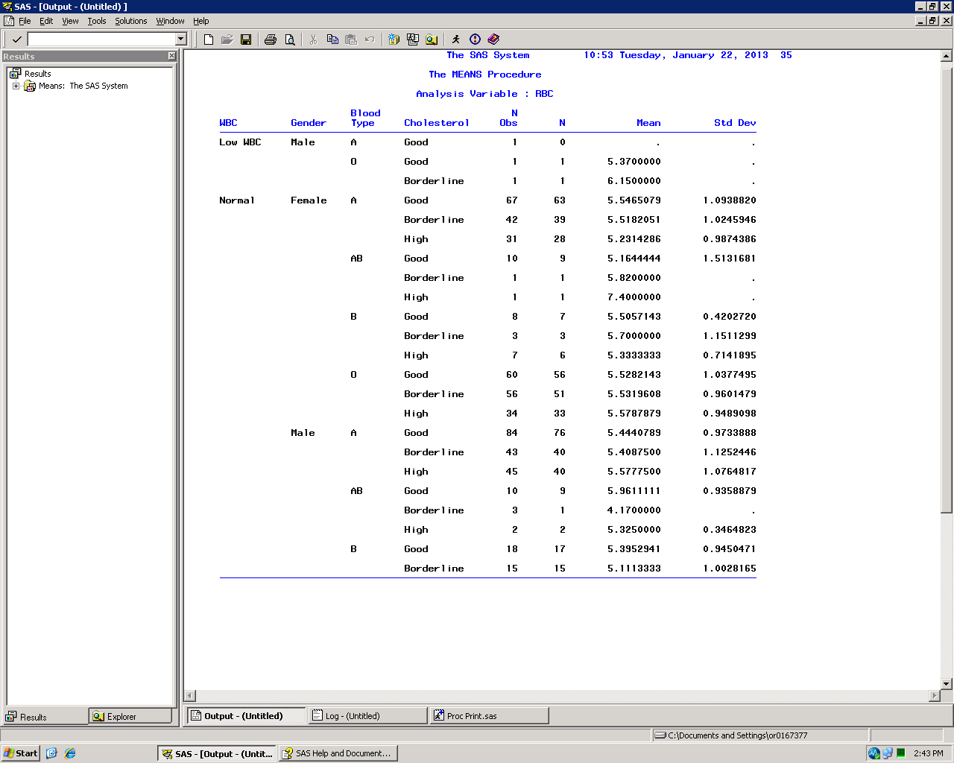
Class variables
Table can also include multiple class variables

Slide 28
Missing data
Where | Default | Override
Analysis variable | Excludes that observation from the calculation of statistics | None

Slide 29
Missing data
N Obs
Number of observations in that class category
N
Number of non-missing values for analysis variable
These are the observations used in calculation of Mean and similar statistics

Slide 30
Missing data (Missing option)
Where | Default | Override
Analysis variable | Excludes that observation from the calculation of statistics | None
Class variable | Excludes that observation from the table | MISSING option

Slide 31
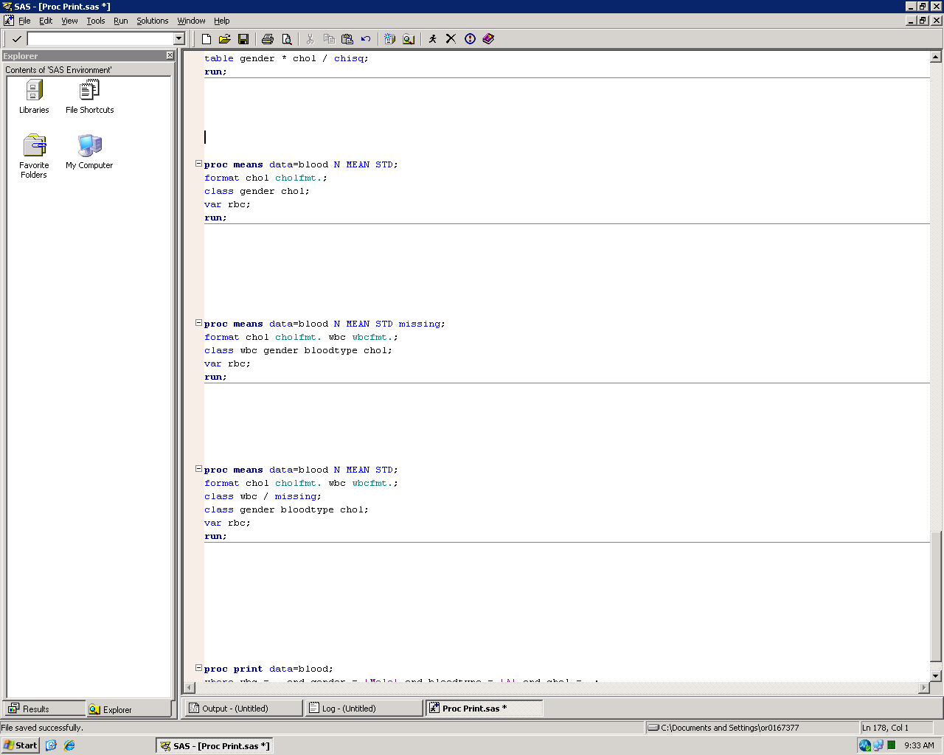
Missing data (Missing option)
Includes all class variables with missing data
Includes selected class variables with missing data

Slide 32
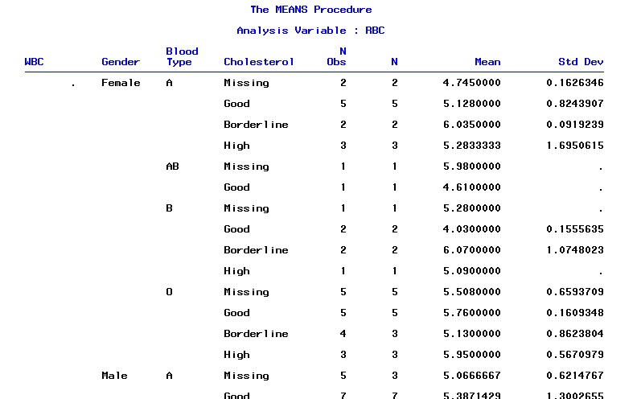
Missing data (Missing option)

Slide 33
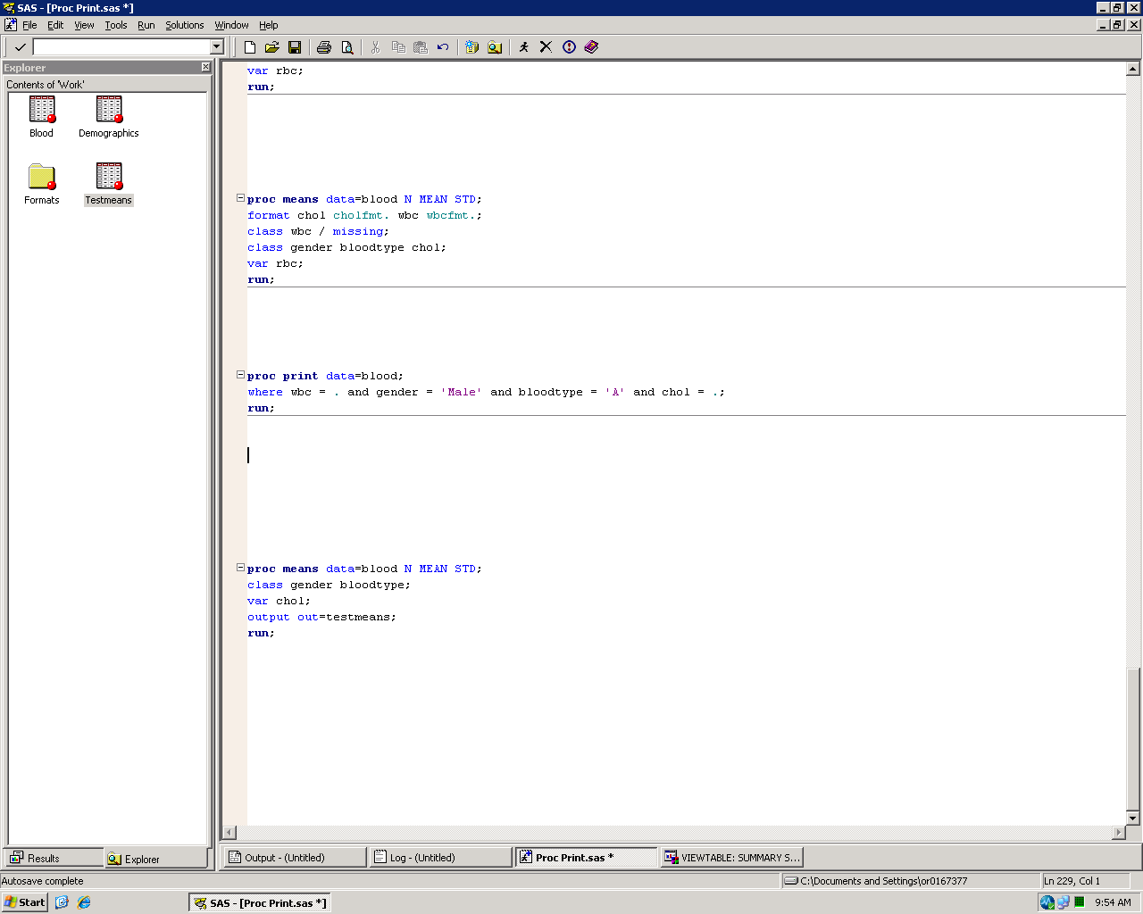
Output statement
Create output datasets using the output statement
out= specifies the name of the output dataset(s)
By default, the output dataset will include N, Mean, Min, Max, and Std. Dev – regardless of which statistics you specify in the PROC Means statement – for all levels of your class variable(s)

Slide 34
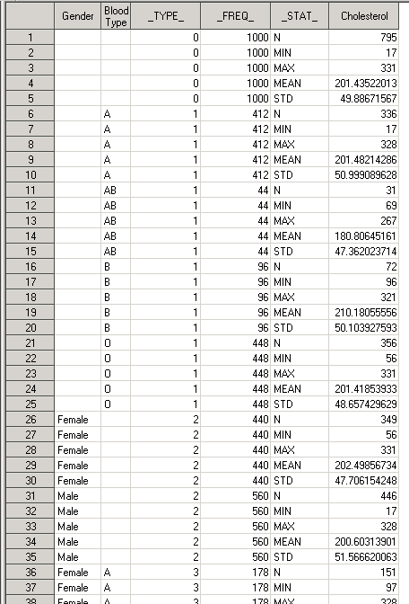
Output statement
Gender/Blood type : Class variables
_TYPE_ : Level of class variable(s)
_FREQ_ : Number of observations in that class category (N Obs)
_STAT_ : Name of the statistic
Cholesterol : Analysis variable

Slide 35
Output statement (_TYPE_)
_TYPE_ : Level of class variable(s)
0 = All observations
1 = Classified by Blood Type only
2 = Classified by Gender only
3 = Classified by both Blood Type and Gender

Slide 36
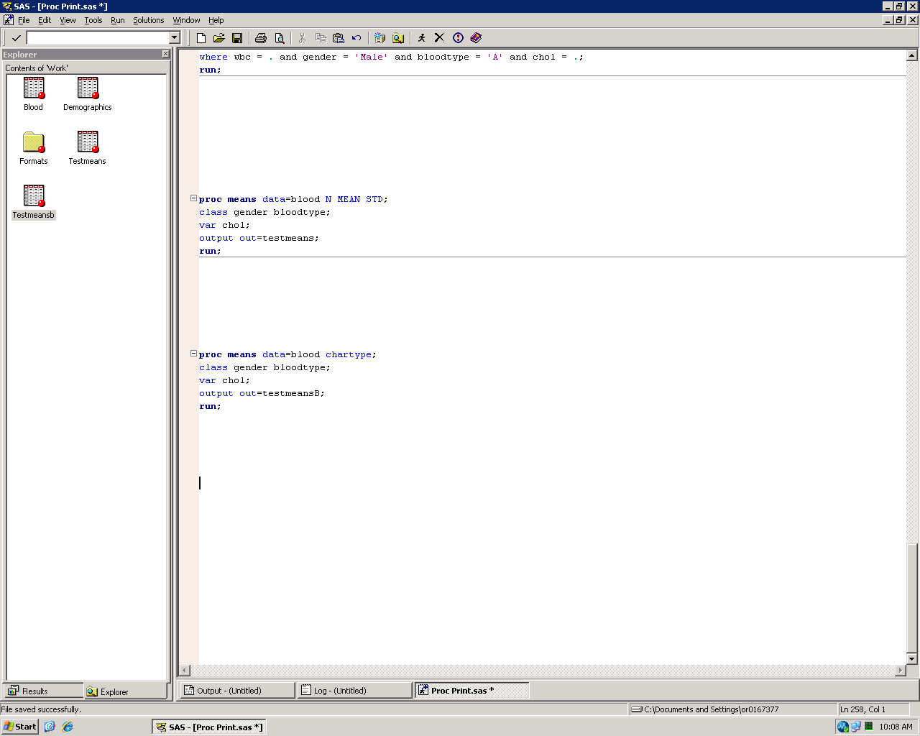
Output statement (_TYPE_)
Can replace the _TYPE_ variable with a binary representation of the class variables using the chartype option
(Short for Character Type)

Slide 37
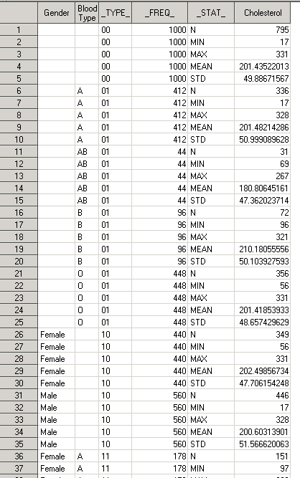
Output statement (_TYPE_)
_TYPE_ : Level of class variable(s) (using chartype)
Gender | Blood Type | Interpretation
0 | 0 | All observations
0 | 1 | Blood Type only
1 | 0 | Gender only
1 | 1 | Blood Type x Gender

Slide 38
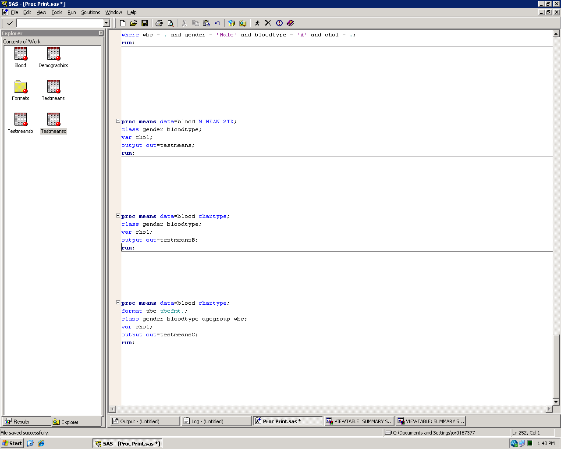
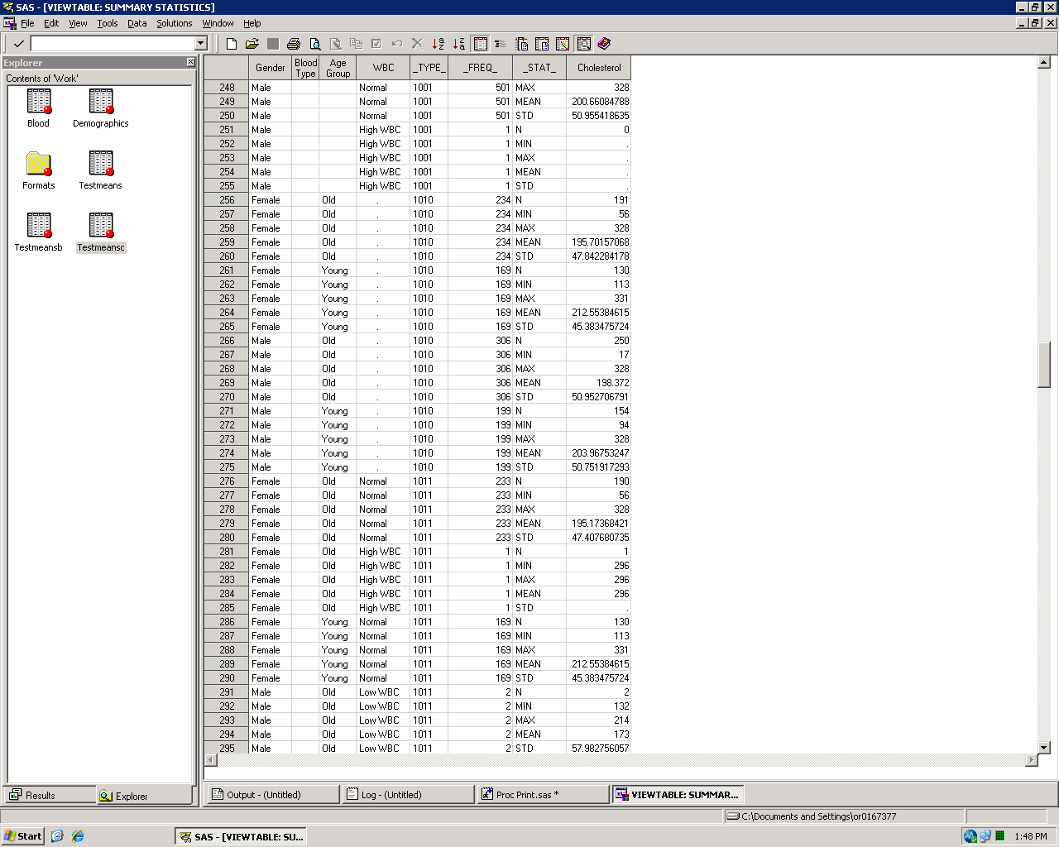
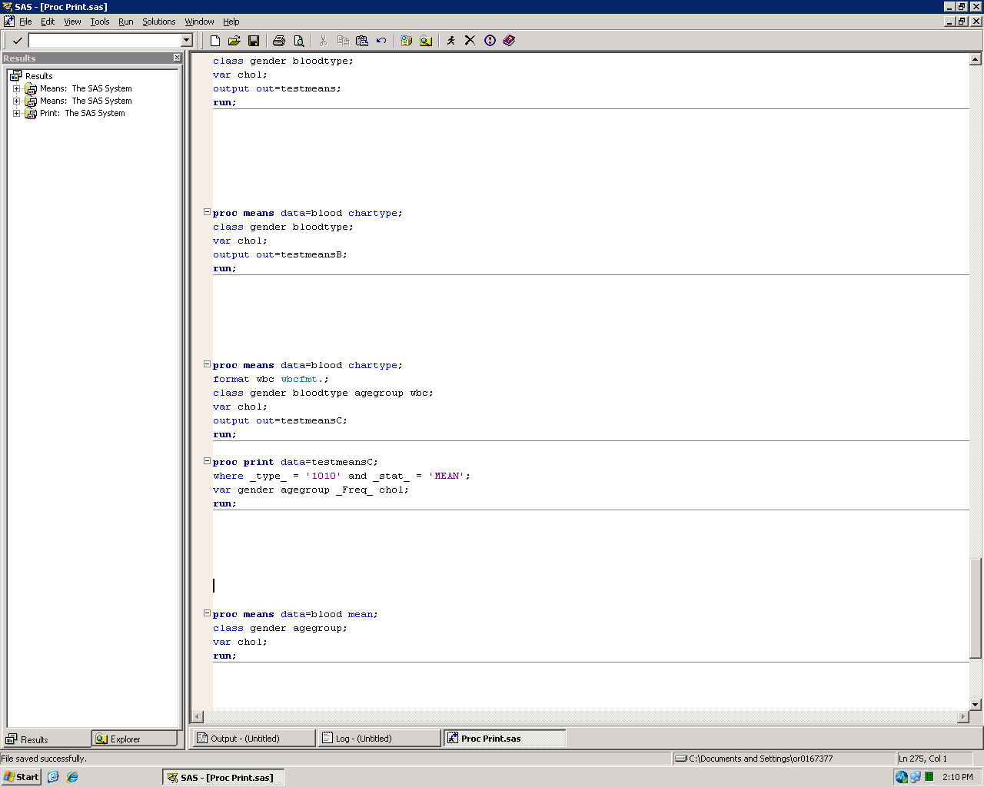
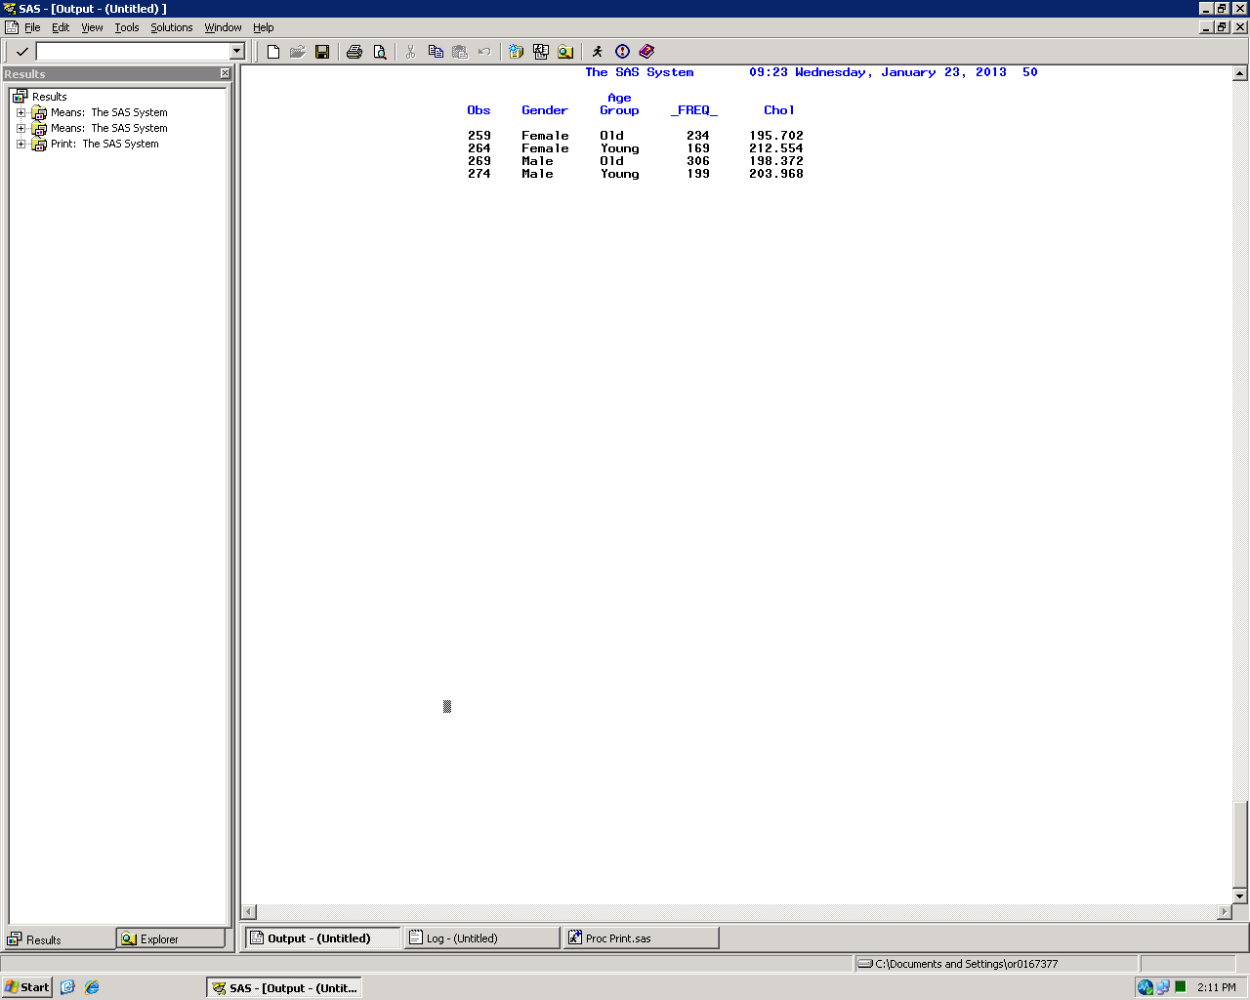
Output statement (_TYPE_)

Slide 39
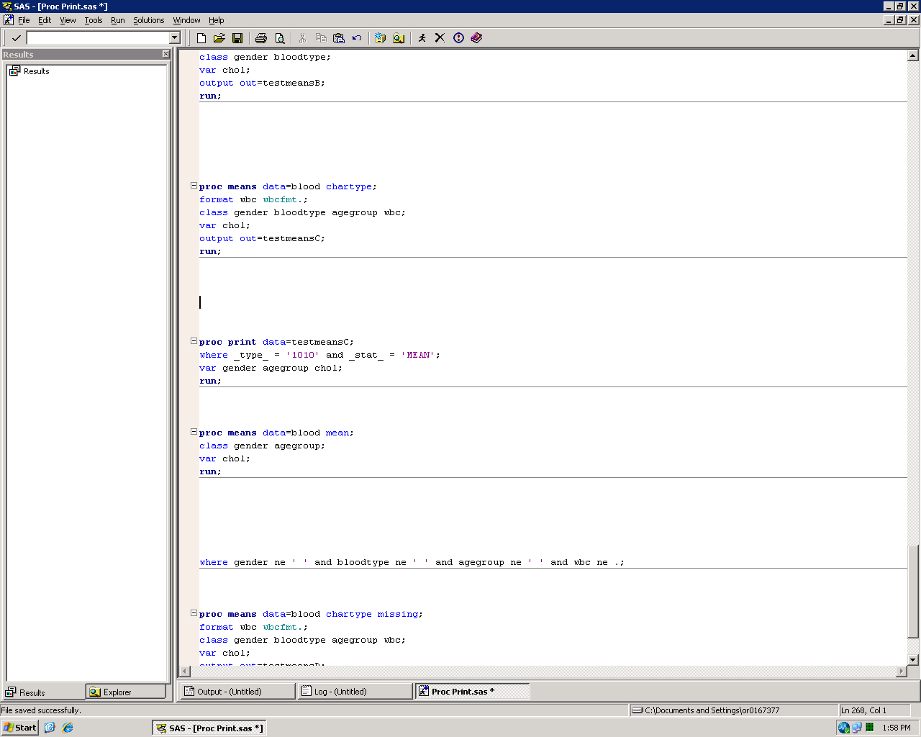
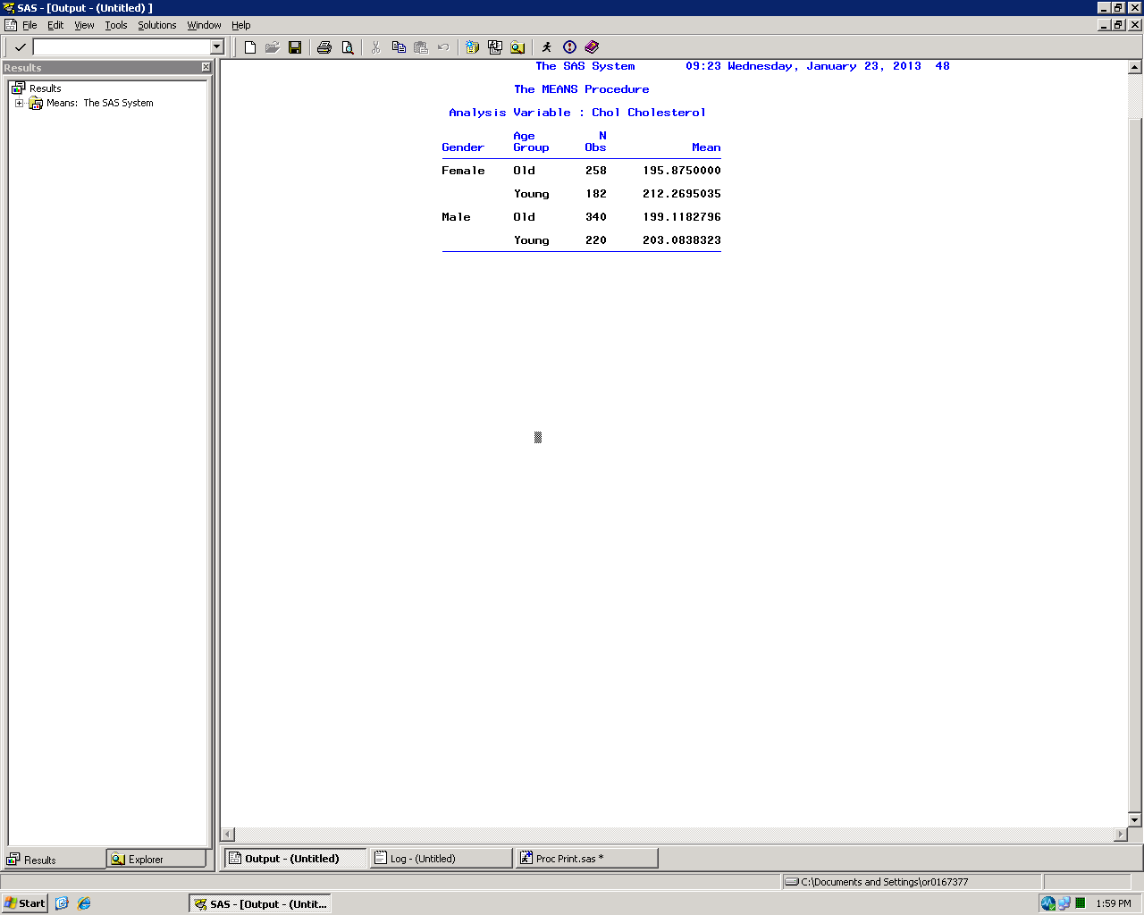
Output statement (Missing data)

Slide 40
Output statement (Missing data)
Lesson:
If an observation is missing data for a class variable, that observation is excluded from all analyses in the procedure

Slide 41
Output statement (Missing data)

Slide 42
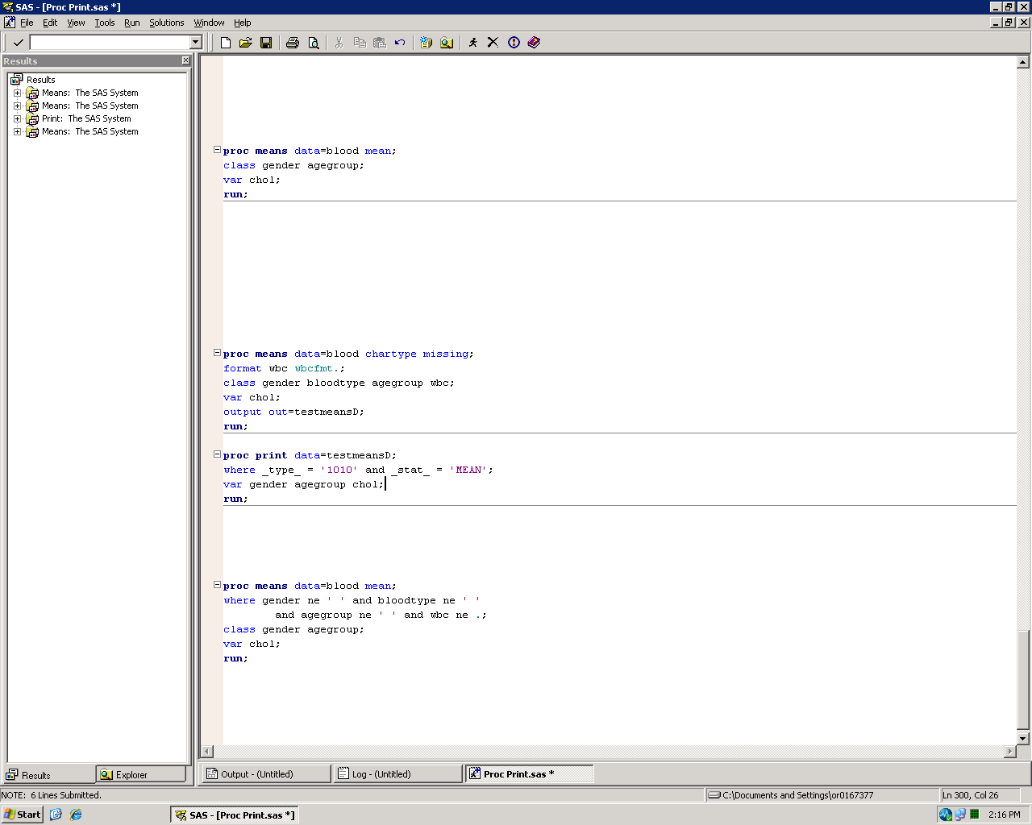
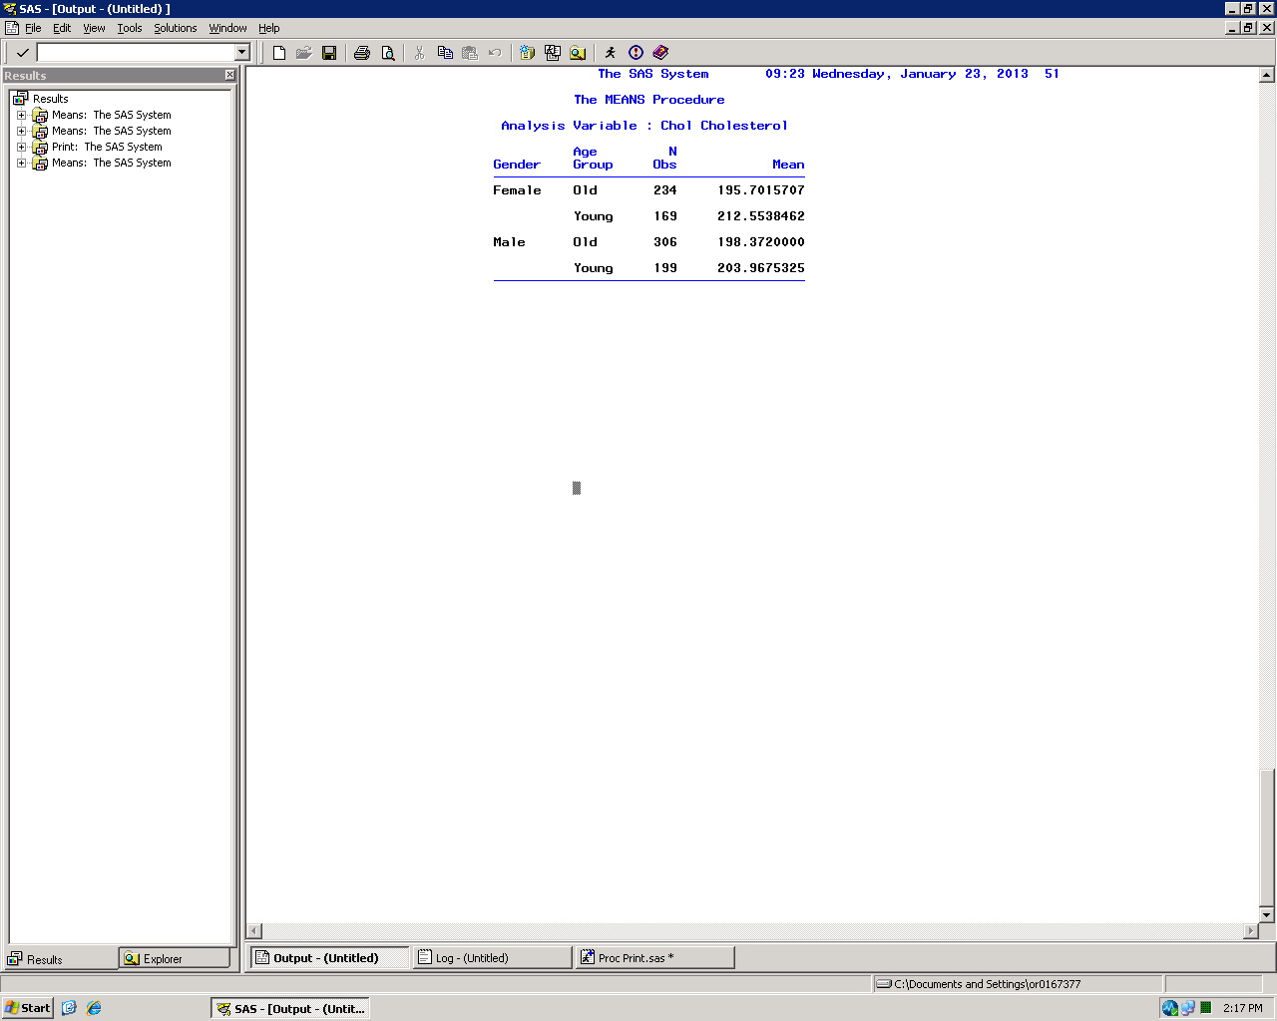
Output statement (Missing data)

Slide 43
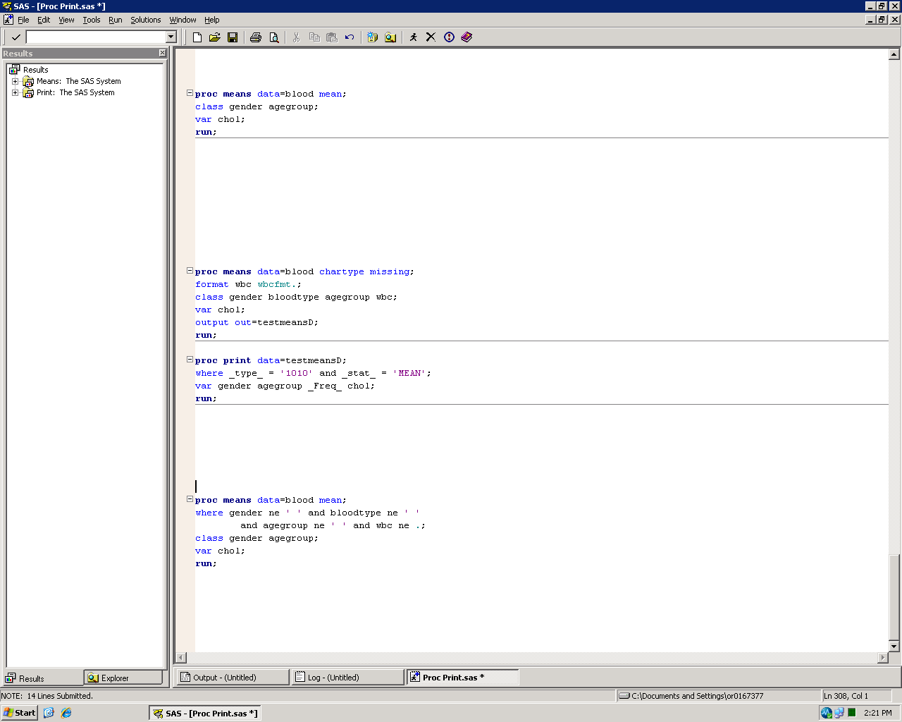
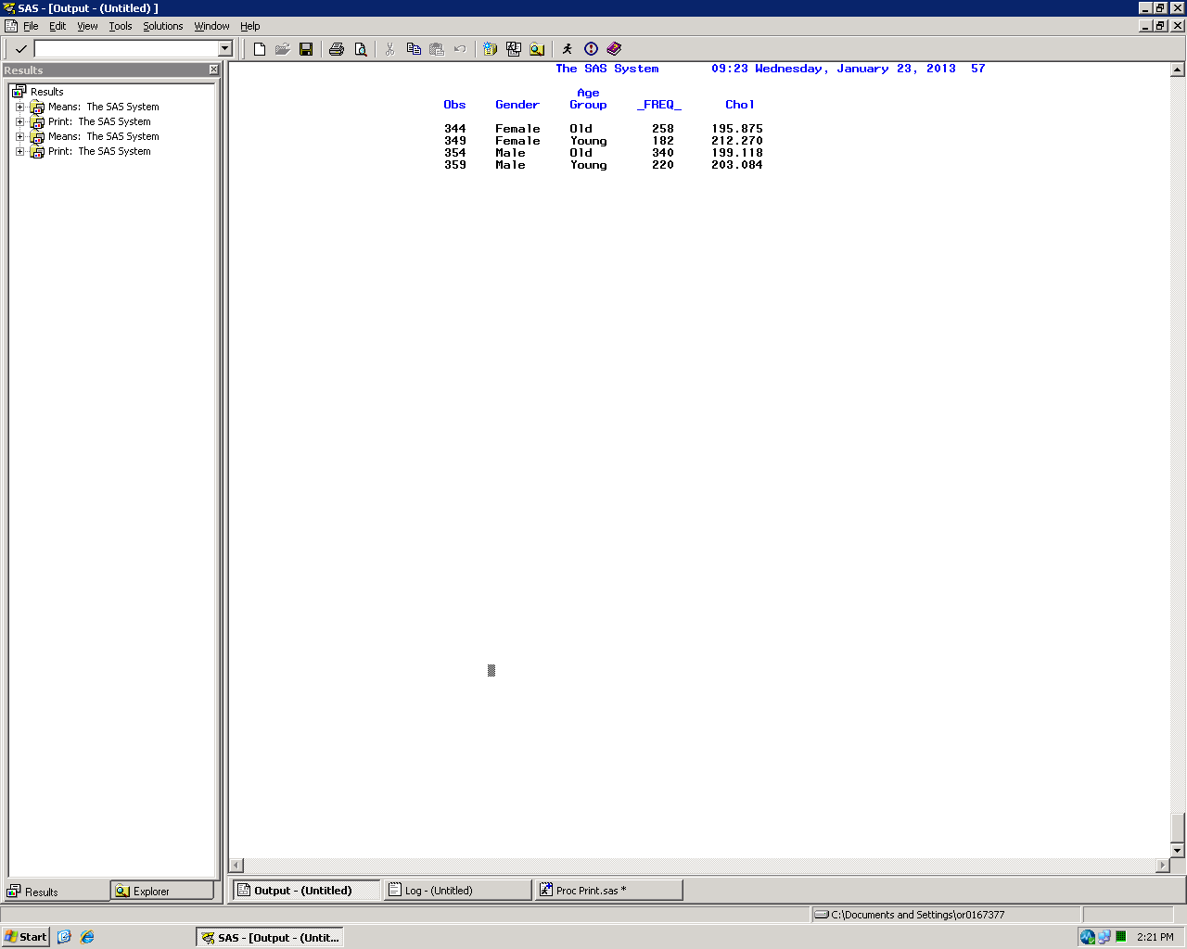
Output statement (Missing data)

Slide 44
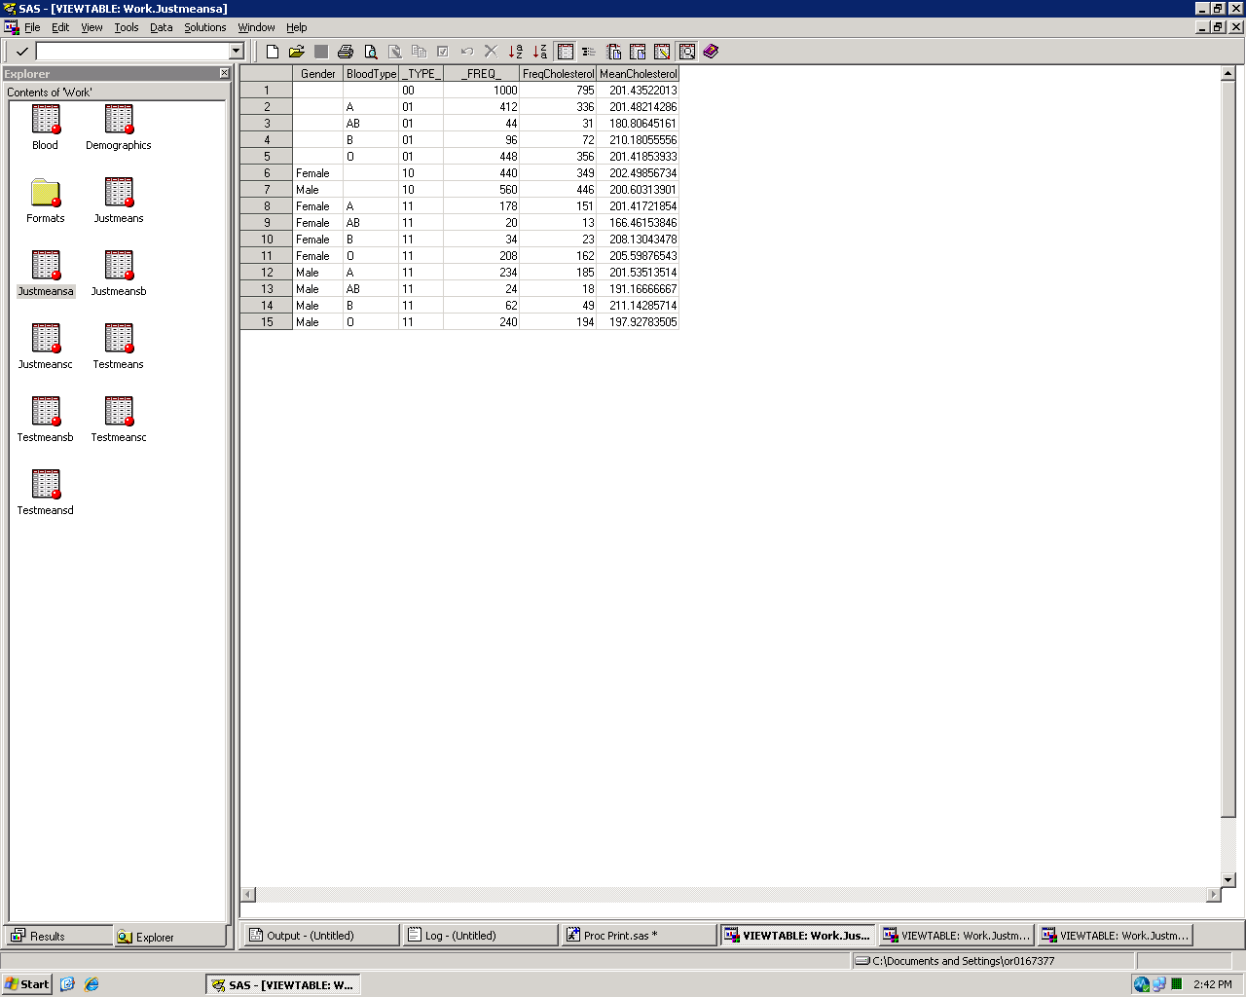
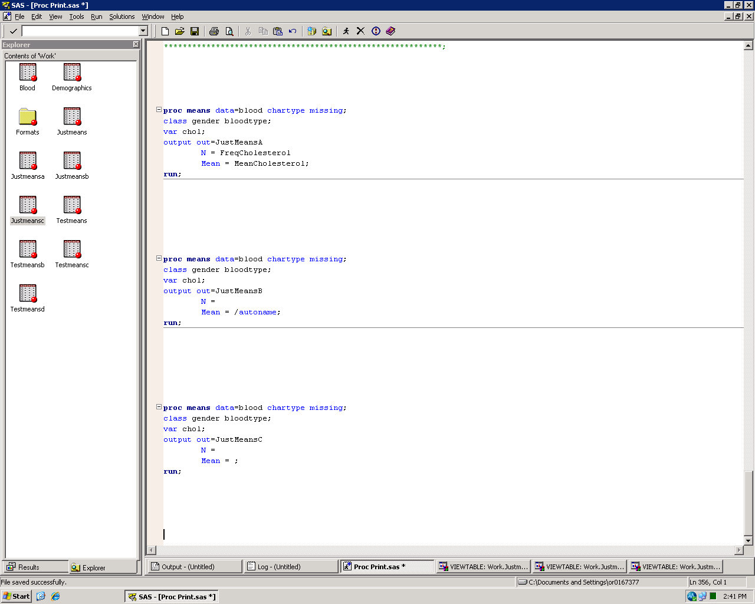
Output statement
You can specify which statistics to include through the output statement
Statistic
New variable name

Slide 45

Output statement
Use the autoname function to automatically generate new variable names

Slide 46
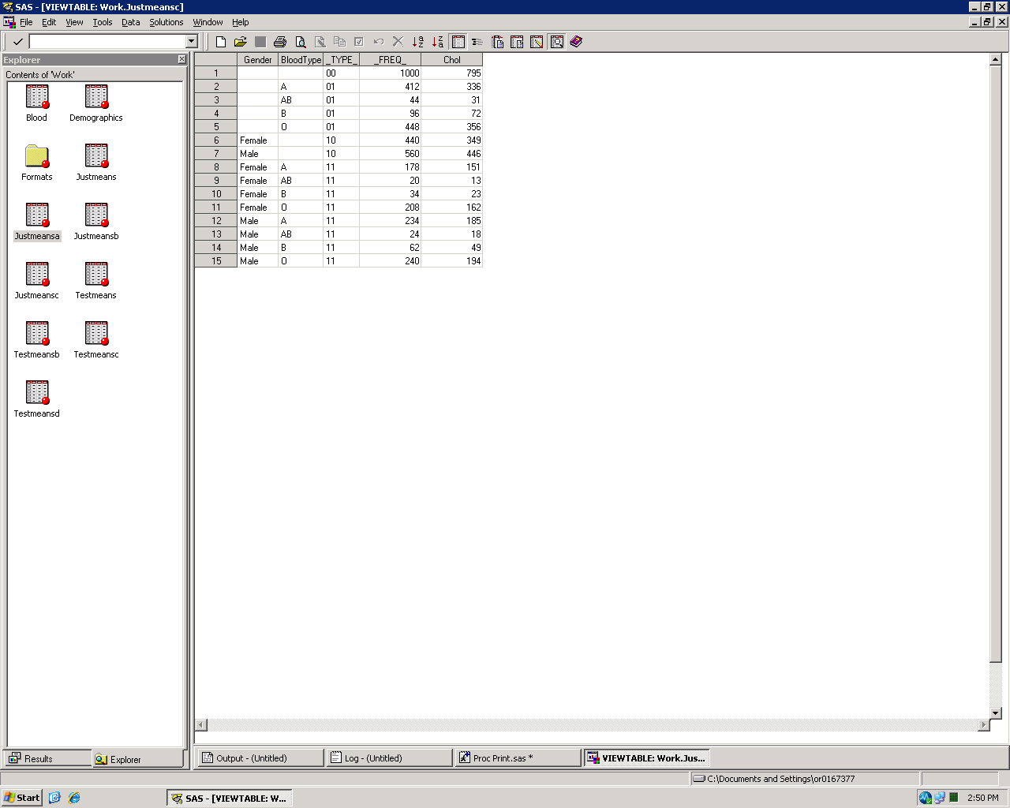
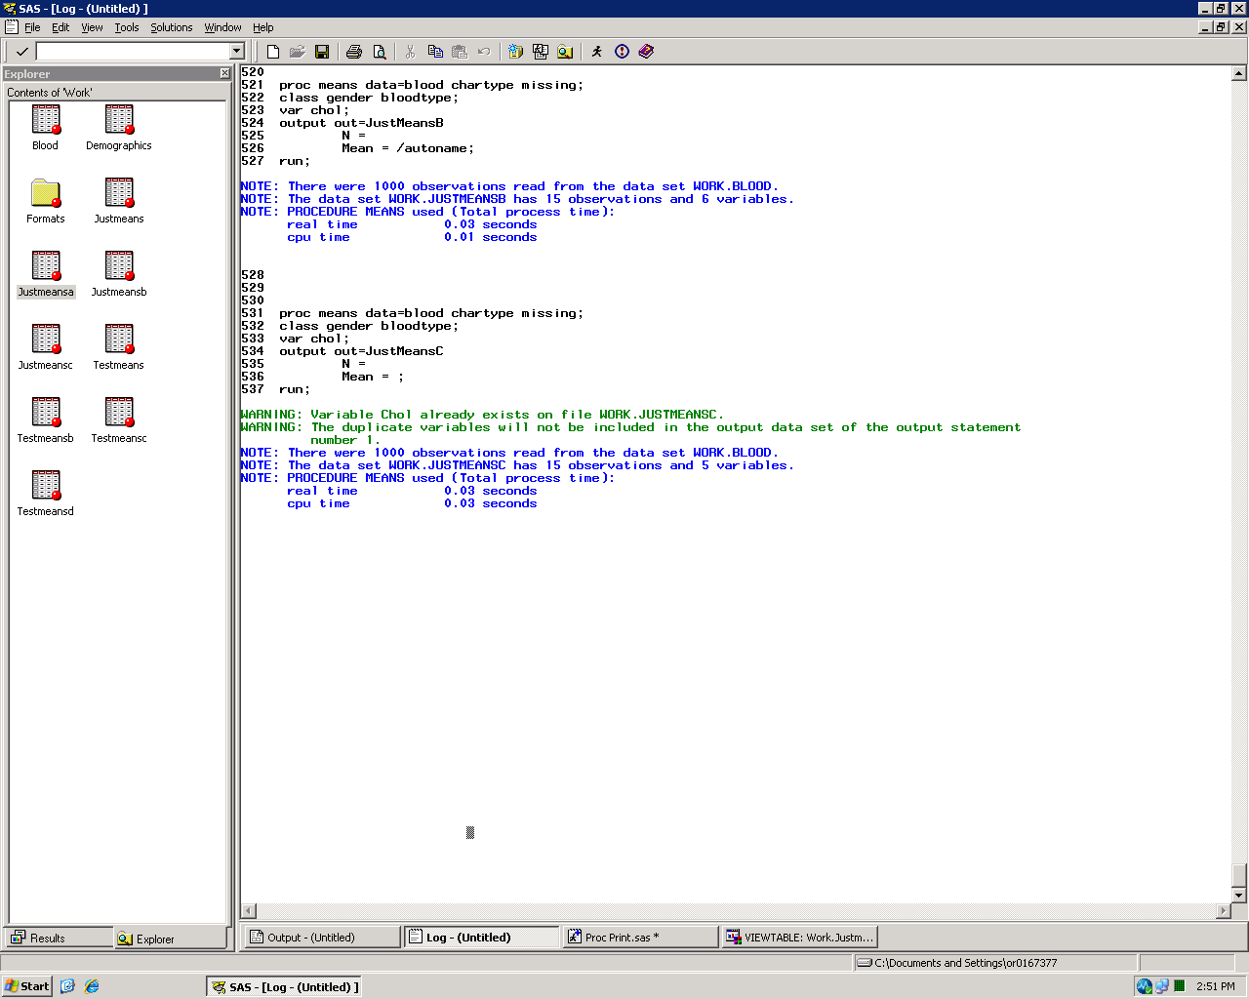
Output statement
If you forget to name your variables, your output will not run correctly

Slide 47


Output statement
Can assign different statistics to each variable

Slide 48

Output statement
Can have multiple output statements with different specifications for each dataset

Slide 49

Output statement

Slide 50

Output statement

Slide 51

Output statement

Slide 52
Additional Reading
Steps to Success with PROC Means
http://www2.sas.com/proceedings/sugi29/240-29.pdf
Advanced Tips and Techniques with PROC Means
http://www2.sas.com/proceedings/sugi27/p018-27.pdf

Slide 53
ODS NOPROCTITLE

Slide 54

ODS
Some procedures (such as FREQ and MEANS) will print a procedure title at the top of their output
This cannot be controlled by title statements

Slide 55


ODS NOPROCTITLE
Use an ODS NOPROCTITLE statement to turn off the procedure titles

